Slide 1
Lab Based Project (B. Tech) Artificial Intelligence Based Multi-Sensor Data Fusion Techniques with DRONE data for Camouflage Target Detection
Presented by
Shrayash Prasad – 20114088
Suryansh Singh – 20114096
Pranay Parashar – 20114073
Under the supervision of
Prof. Dharmendra Singh
Department of Computer Science and Engineering

Slide 2
Outlines
Introduction
Methodology
Experimental Setup
Application based scenarios
Results and outcomes
Other Fields Explored
Applications
Conclusion
Future Scope
Contribution of Group Members
References

Slide 3
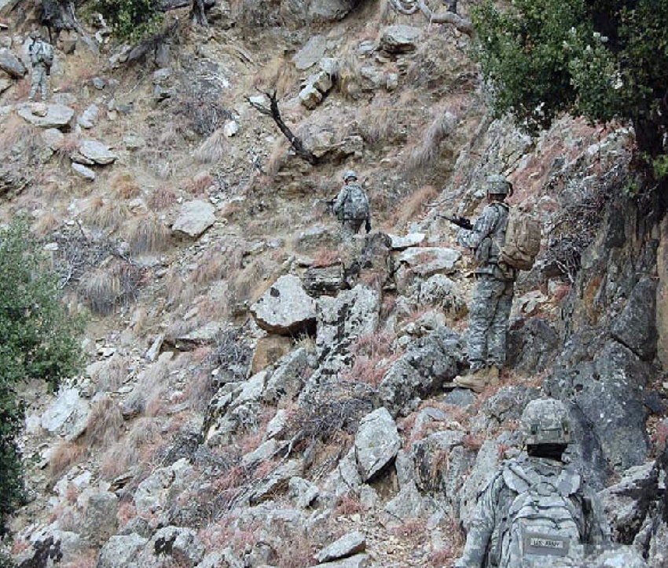
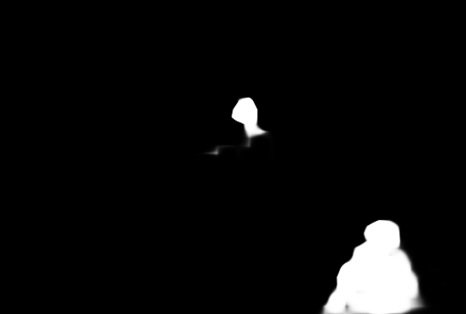
Introduction: Theoretical Background
Camouflage detection is a critical task in the military and security operations, as it can have significant implications on the safety of personnel and the success operations.
Deep learning models have shown significant promise in detecting camouflaged objects in different environments.
One such model is SINet, which is based on a Fully Convolutional Neural Network (FCNN) architecture.
Image showing camouflaged army members
Output of our model

Slide 4
Introduction
Objectives:
The primary objective of our project is to develop an effective and efficient camouflage detection system based on the SINet architecture.
We aim to develop a model which can detect camouflage and salient objects in both RGB and Multi-spectral images.
Motivation:
The motivation behind our project is driven by the critical need for effective camouflage detection in military and security operations and various other fields like medical, agriculture, etc.
Camouflage is a technique used by adversaries to conceal objects and personnel from view, making it difficult for military and security personnel to detect and respond to potential threats.

Slide 5
Methodology
Our project consist of different modules, and they have their own usage. Here we specify in brief about each of them.
Image Segmentation
It is a method of dividing a digital image into subgroups called image segments, reducing the complexity of the image and enabling further processing or analysis of each image segment.
It is the assignment of labels to pixels to identify objects, people, or other important elements in the image.
Instead of processing the entire image, a common practice is to first use an image segmentation algorithm to find objects of interest in the image.

Slide 6
Methodology
Image Segmentation
Then, the object detector can operate on a bounding box already defined by the segmentation algorithm. This prevents the detector from processing the entire image, improving accuracy and reducing inference time.
It is used for many practical applications including medical image analysis, computer vision for autonomous vehicles, face recognition and detection, video surveillance, and satellite image analysis.

Slide 7
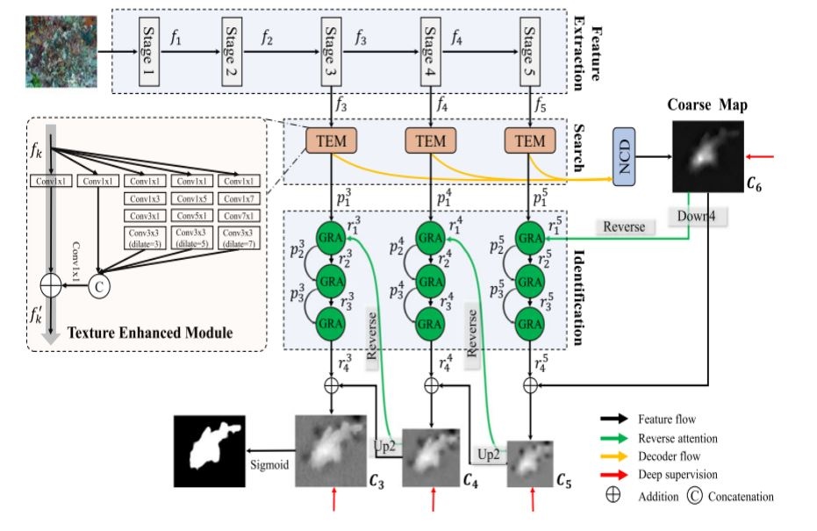
Methodology
Our project consist of different modules, and they have their own usage. Here we specify in brief about each of them.
Model Architecture (SINet Framework)

Slide 8
Methodology
Our SINet model consists of the first two stages of hunting, i.e., search and identification. Specifically, the former phase is responsible for searching for a concealed object, while the latter one is then used to precisely detect the concealed object in a cascaded manner.
The architecture consists of three main modules :
a) The Texture Enhanced Module (TEM).
b) The Neighbor Connection Decoder (NCD)
c) The Cascaded Group Reversal Attention (GRA) blocks.

Slide 9
Methodology - SINet
Texture Enhanced Module:
TEM in SINet plays a crucial role. It enhances the discriminative power of the extracted features within a small or local space. By focusing on specific regions or areas of interest, the TEM helps to emphasize important details and enhance the differences between camouflage objects and the background.
Overall, the usage of TEM in SINet for camouflage detection aims to improve the network's ability to distinguish camouflage patterns from the background by incorporating more discriminative feature representations during the searching stage.
B) Neighbor Connection Decoder
After the input image is processed through the encoding layers, which extract hierarchical features at different scales, the resulting feature maps may contain relevant information for camouflage detection. However, these feature maps might lack spatial details and may not be optimal for precise localization and segmentation.

Slide 10
Methodology
To address this, the Neighbor Connection Decoder establishes connections between feature maps at different scales, allowing for the integration of both local and global information. These connections enable the decoder to refine the feature maps and generate a more accurate and detailed output.
C) Group-Reversal Attention blocks
The Cascaded Group-Reversal Attention (GRA) blocks, work collaboratively to refine the coarse prediction from the deeper layer.
It is a residual learning process. Residual learning, also known as skip connections, is a technique used in deep learning networks to address the degradation problem associated with training very deep neural networks.

Slide 11
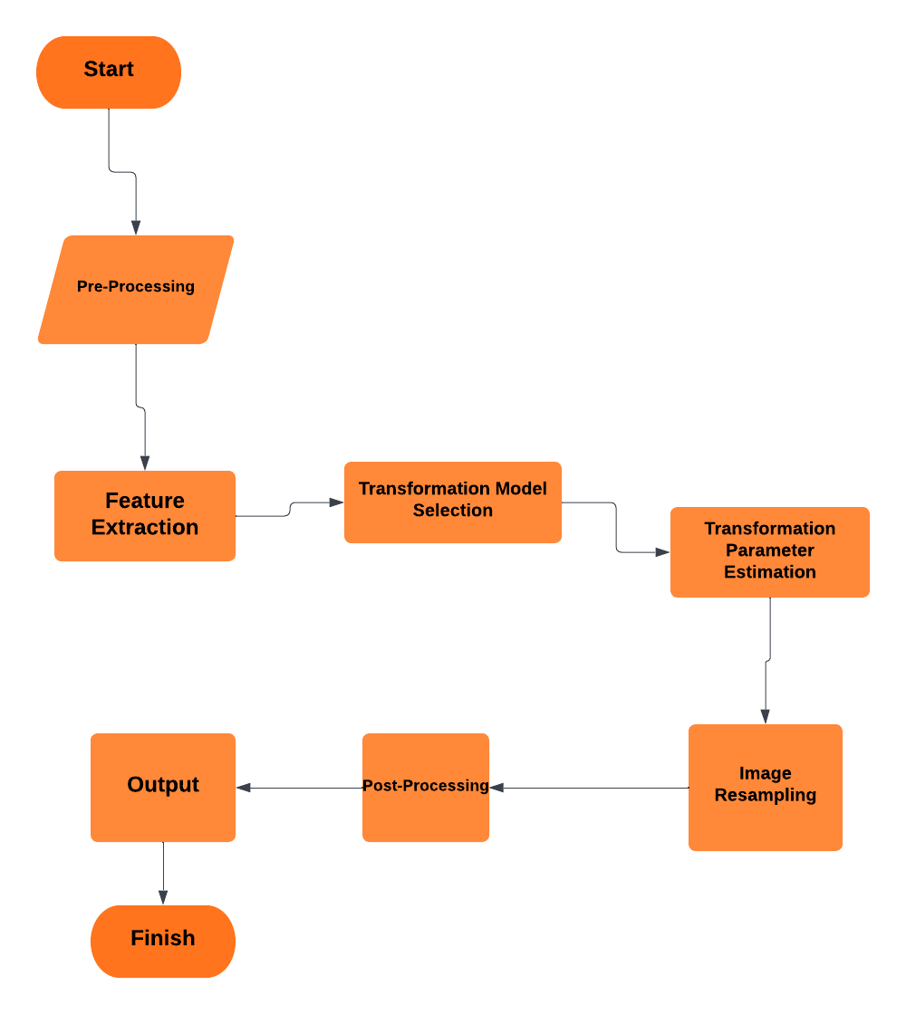
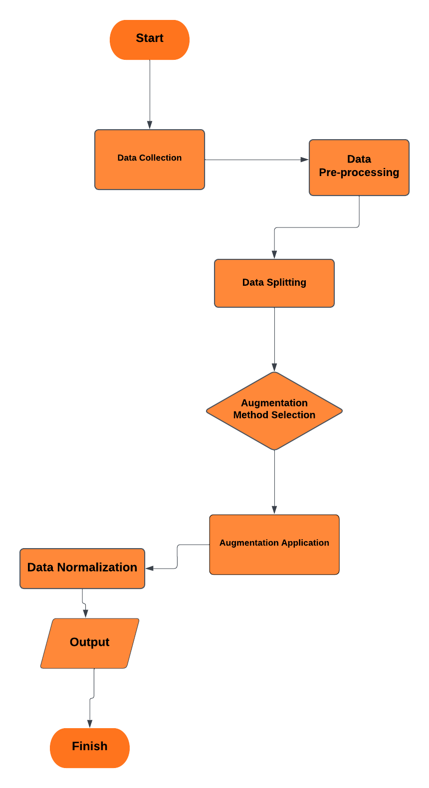
Methodology – Flow Charts
Image Registration
Data Augmentation

Slide 12
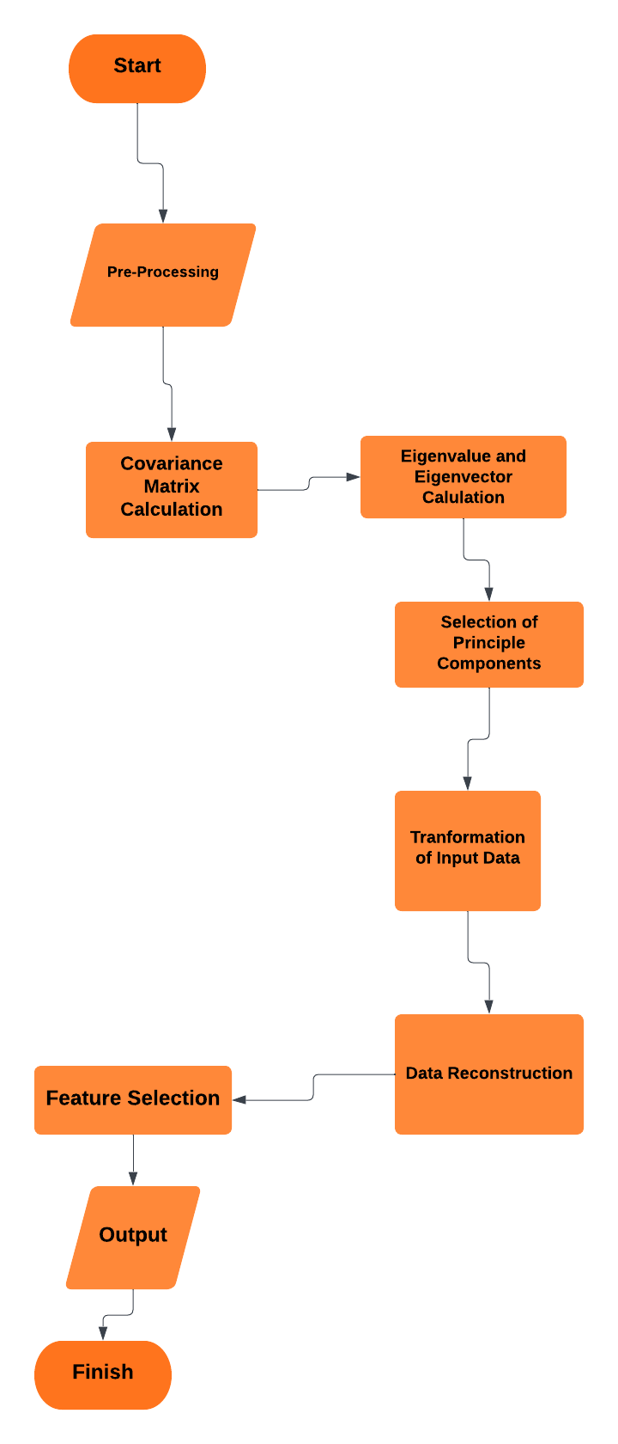
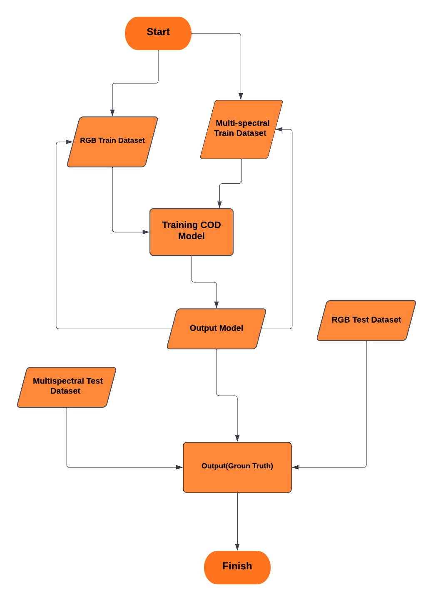
Methodology – Flow Charts
Principle Component Analysis
COD Model

Slide 13
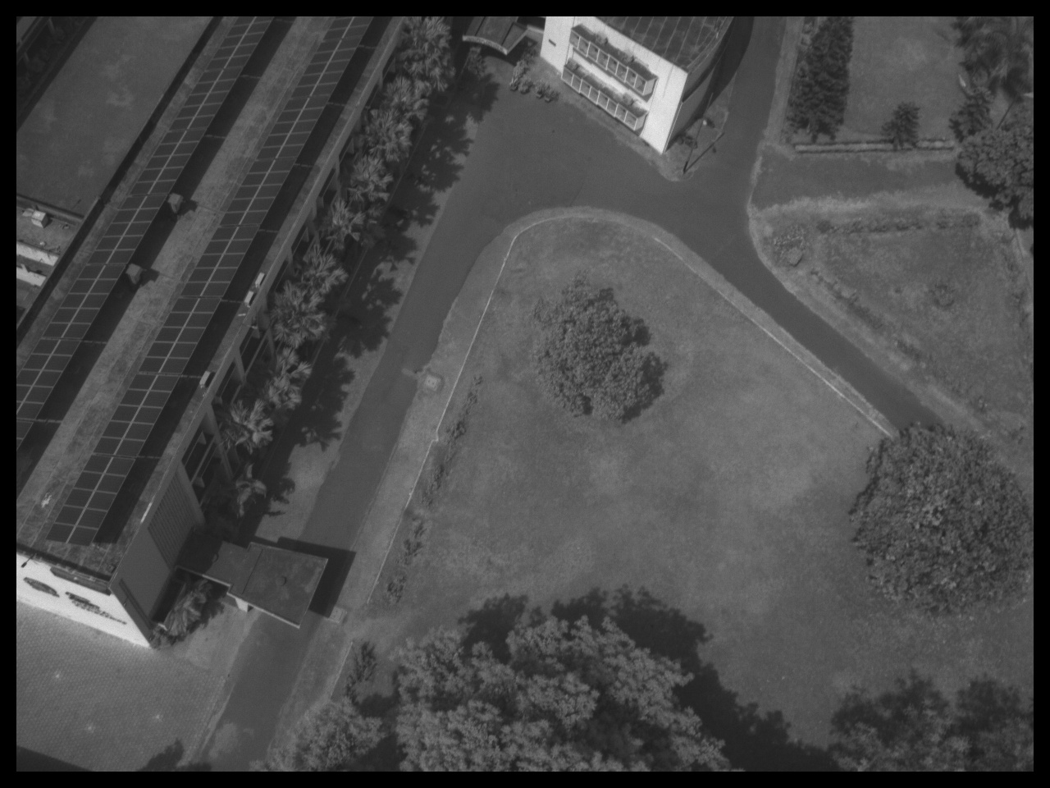
Methodology
Image Registration
Used to align 5 images taken by the drone at different angles to reduce the noise while combining them to create 3-channelled image.

Slide 14
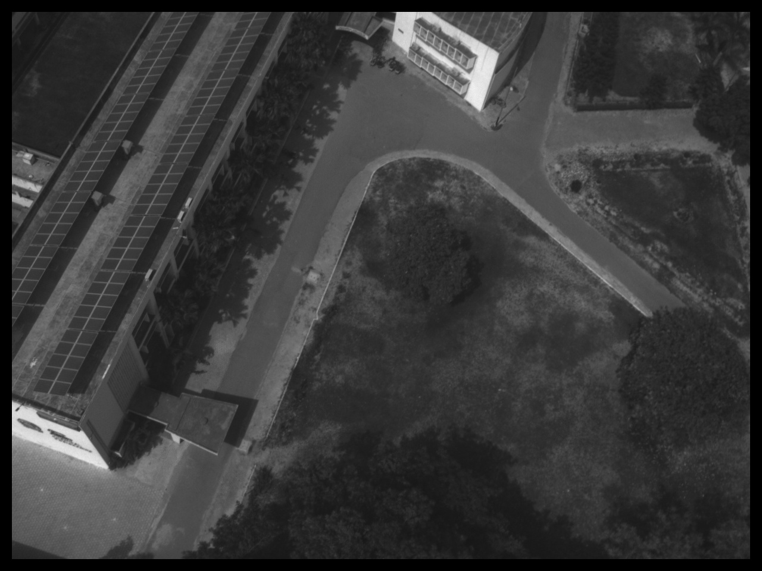
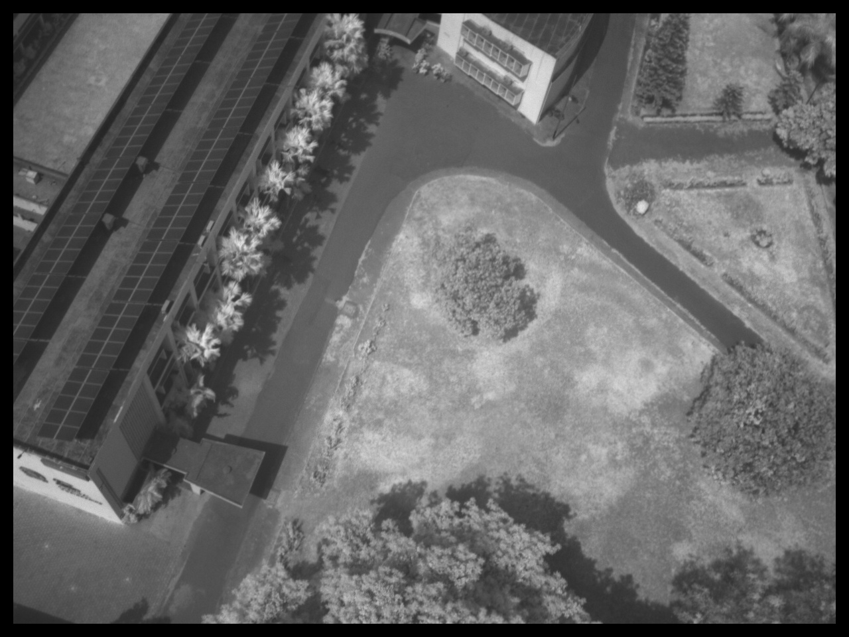
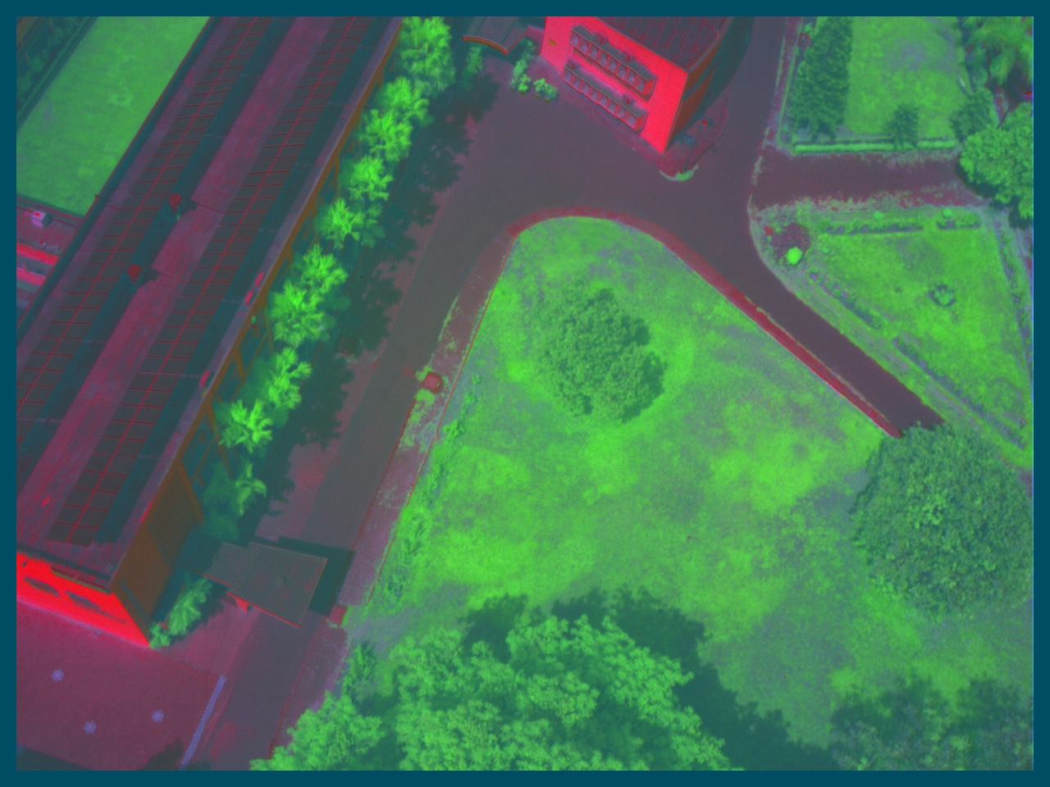
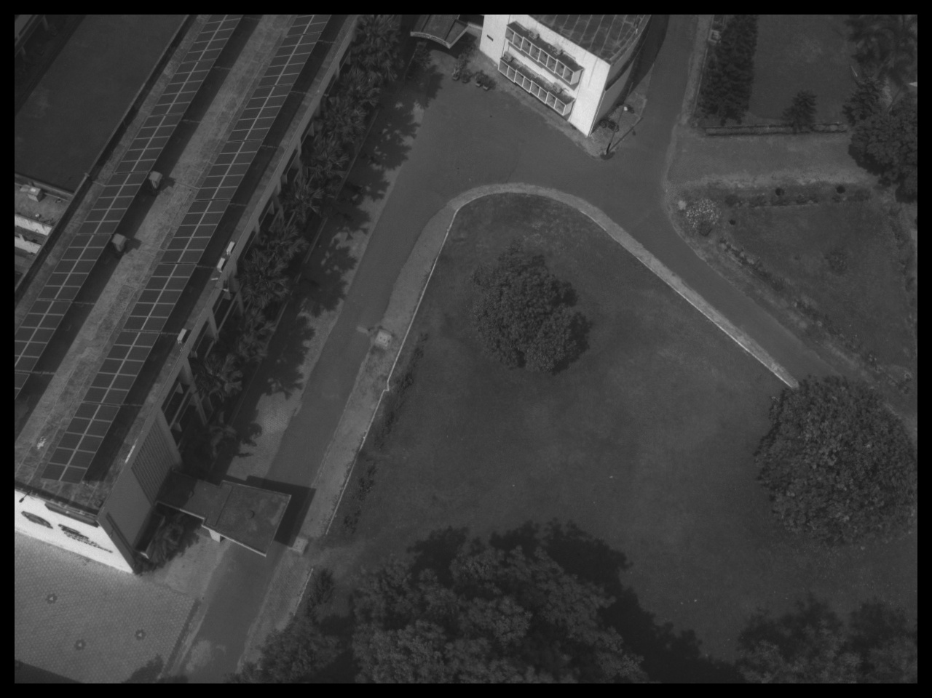
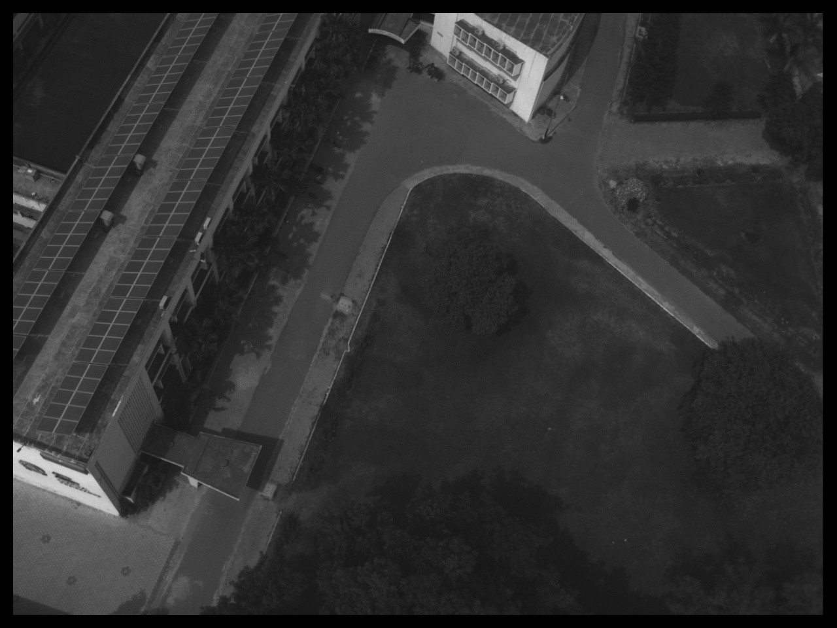
Methodology
Principle Component Analysis
PCA is used here for feature extraction and reduction of parameters of a
5-channelled multispectral image to a 3-channelled multispectral image.

Slide 15
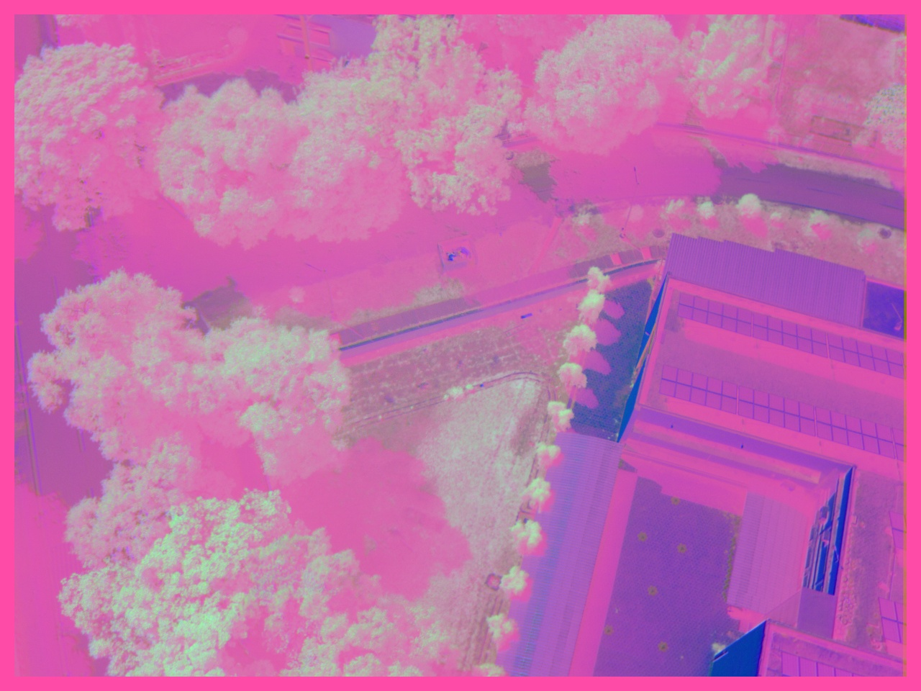
Methodology
Data Augmentation
In this scenario, we employed data augmentation techniques to increase the amount of multispectral training data available for our model. Due to the limited amount of original data, we applied flip and rotate features of augmentation, which allowed us to generate eight distinct variations of the same dataset. By doing so, we were able to significantly expand the size of our training set and improve the overall robustness of our model.
Input Image

Slide 16
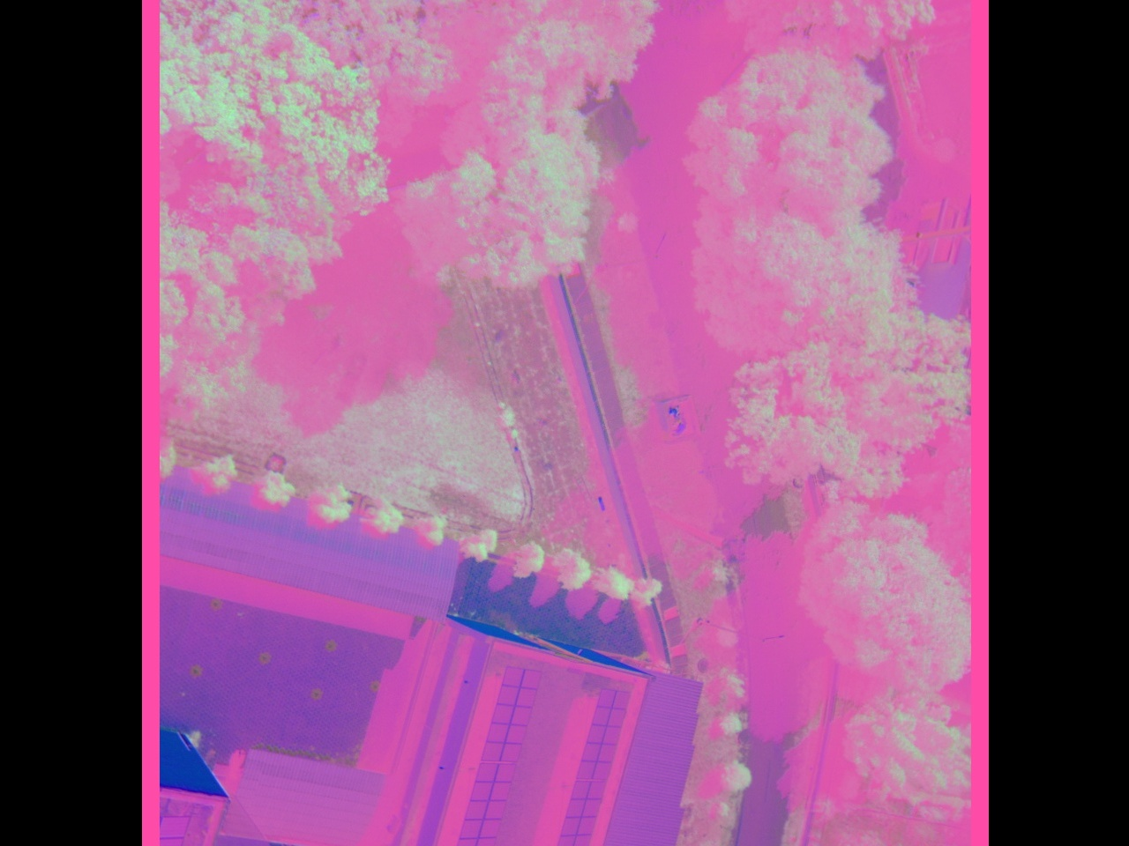
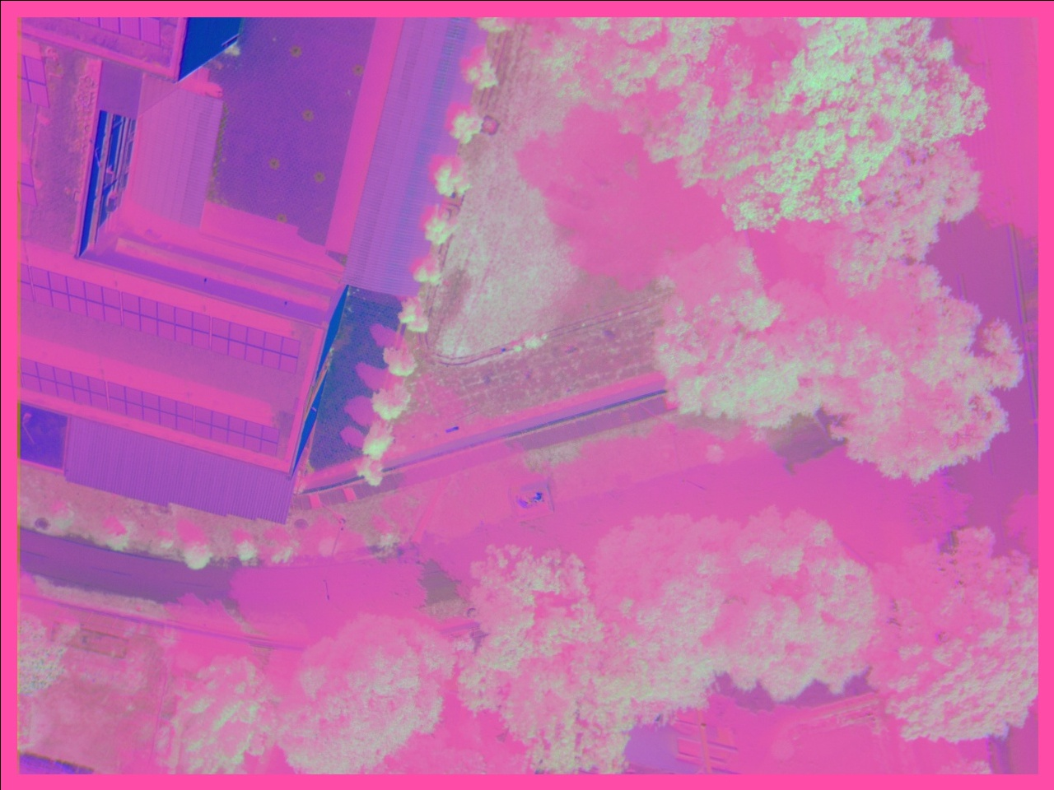
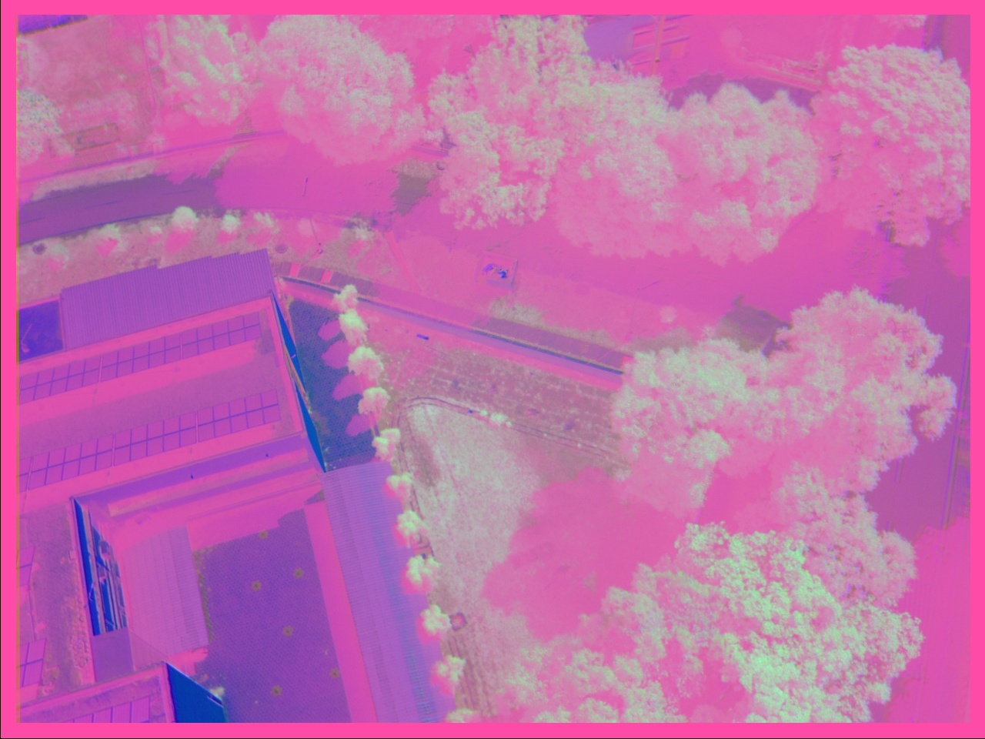
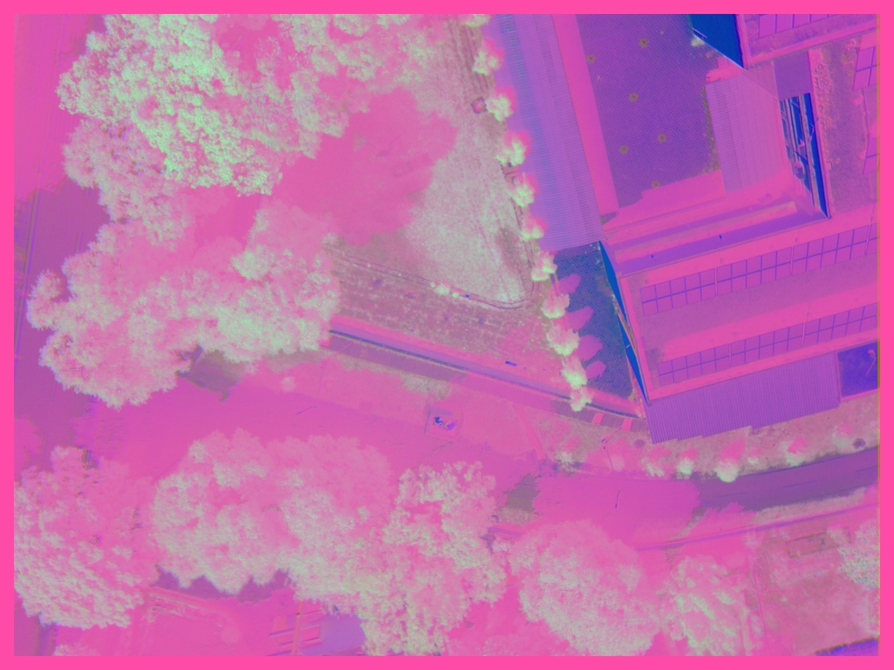
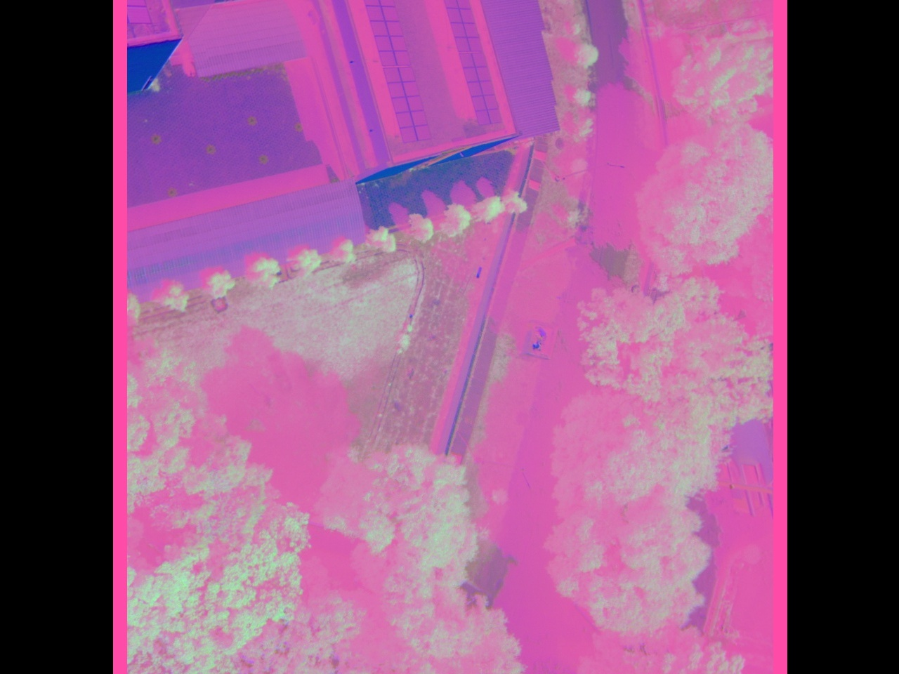
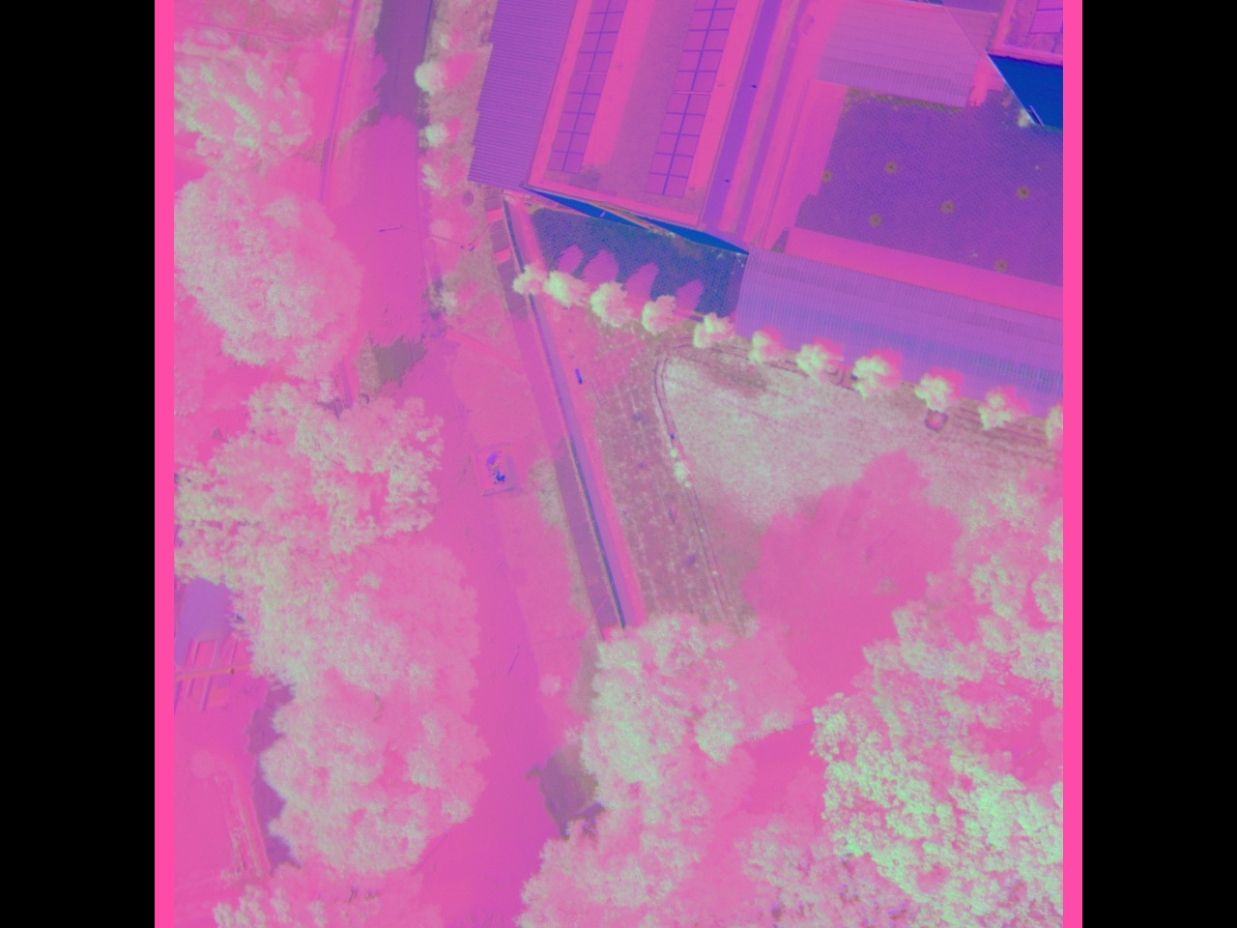
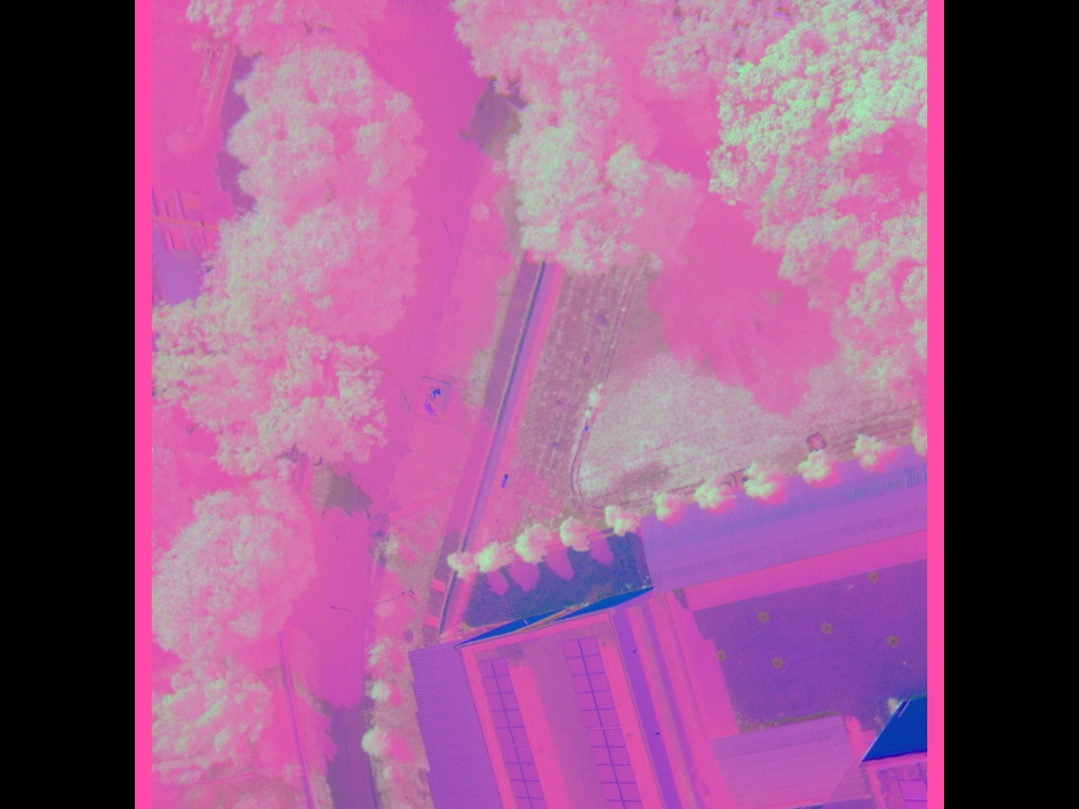

Methodology
Data Augmentation
8 Augmented Images
** The GT of all images are also augmented in the same way.

Slide 17
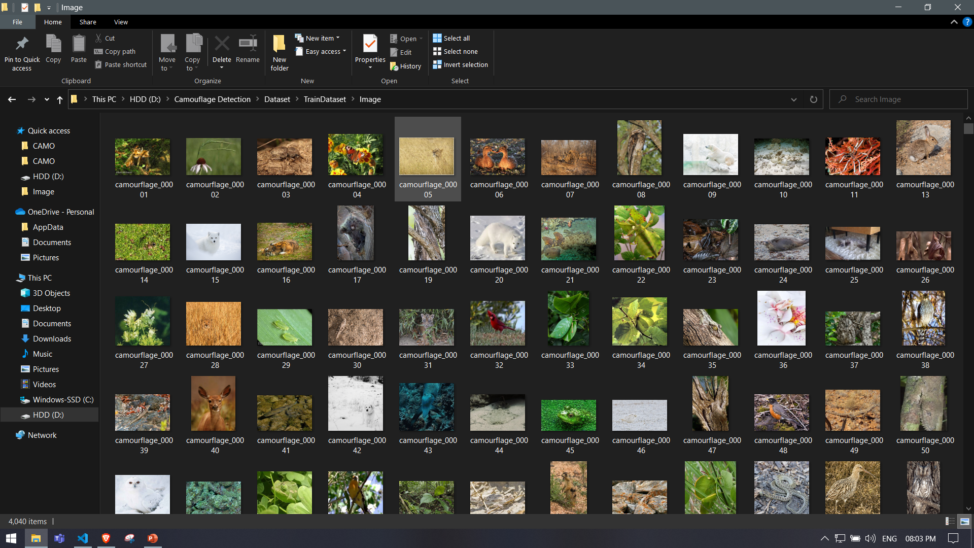
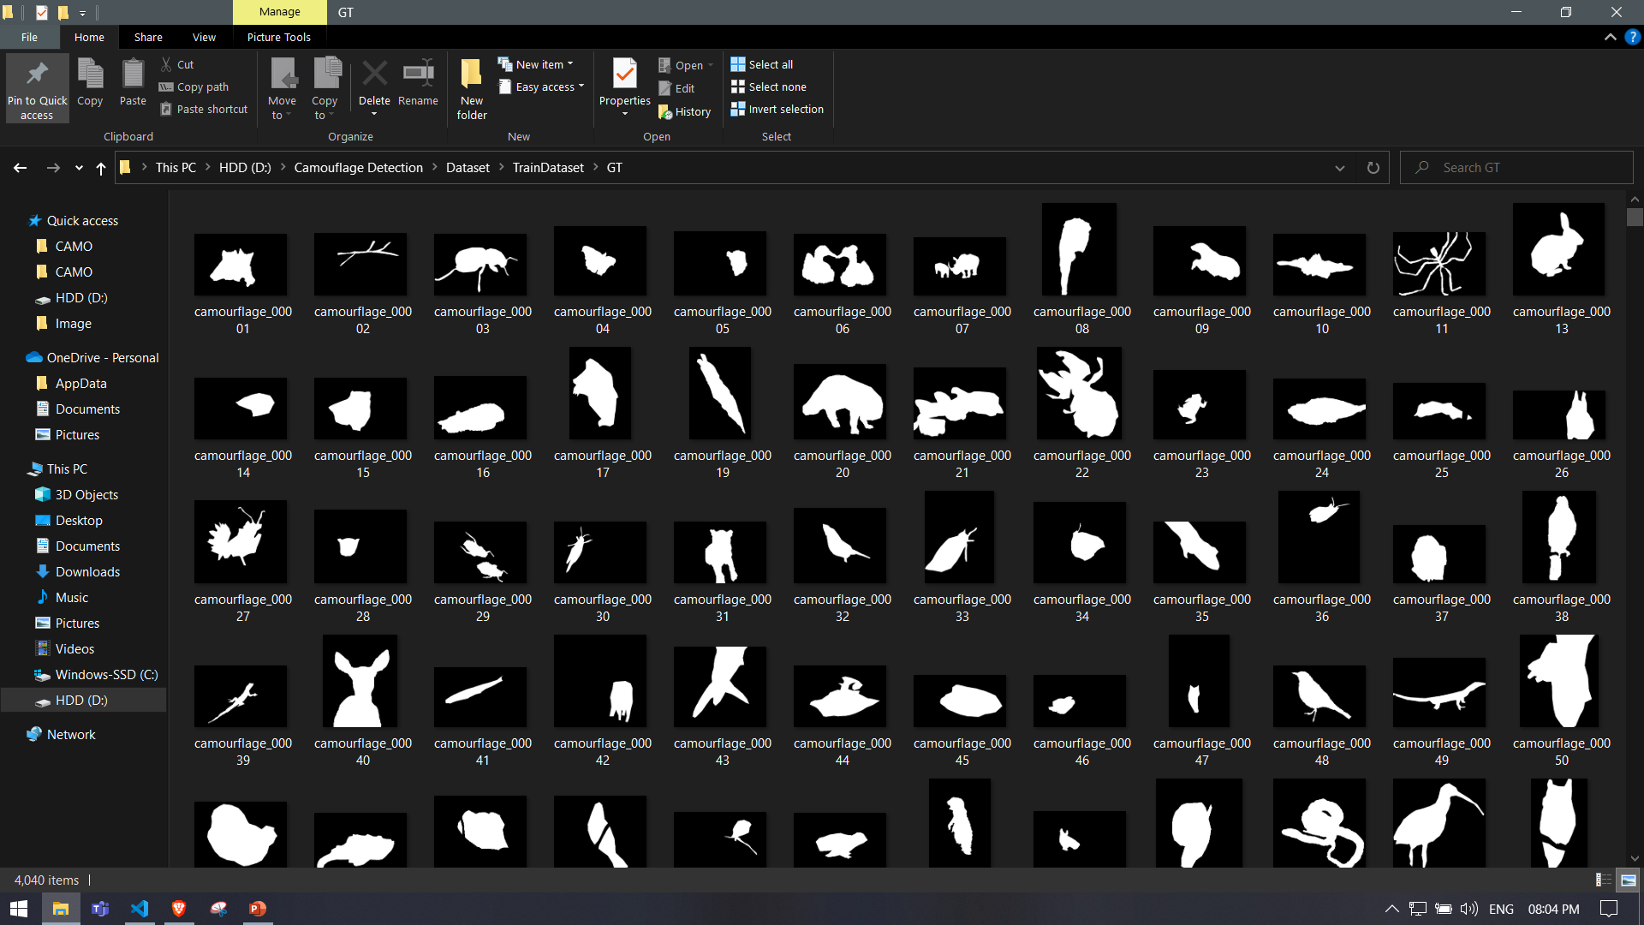
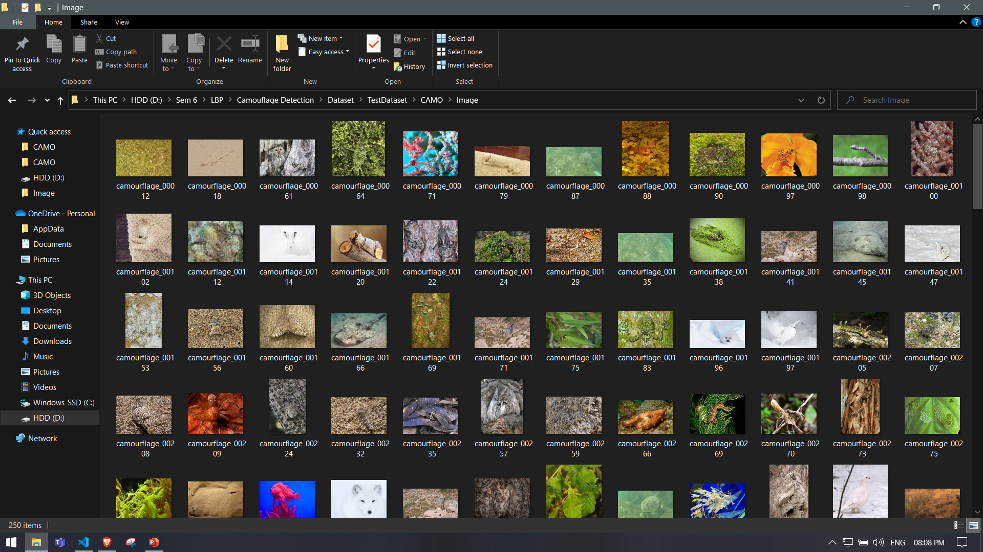
Experimental Setup
Datasets Used
(I) For training model over RGB Images, we used COD10K dataset.
Images
GT
(II) For testing our model over RGB Images, we used CAMO Dataset containing 250+ images.

Slide 18
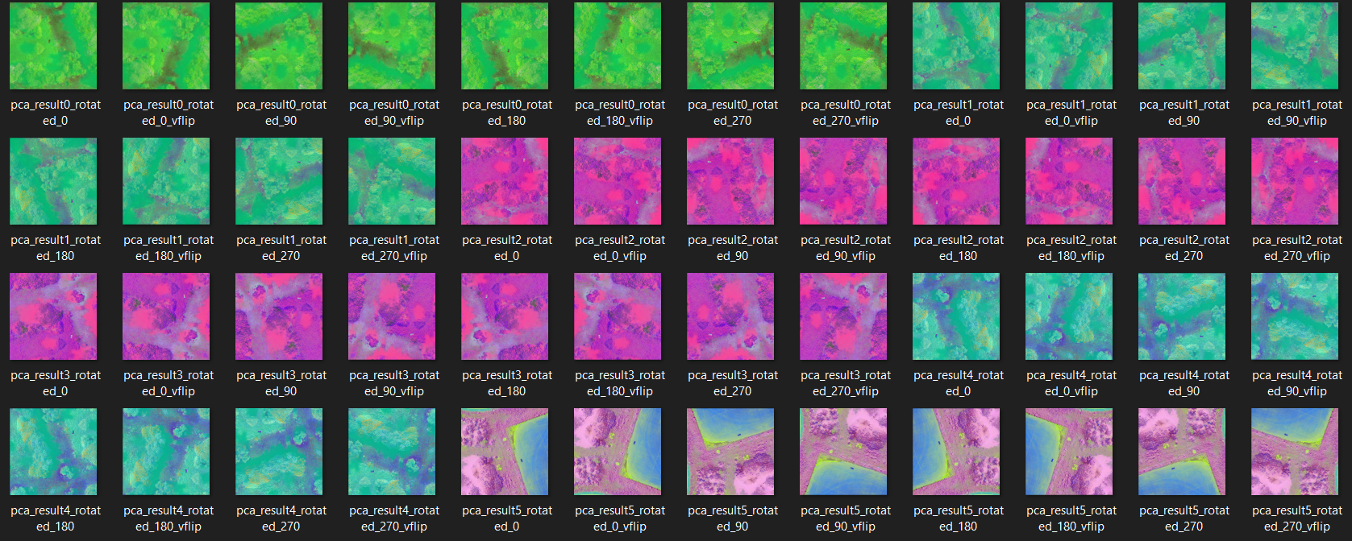
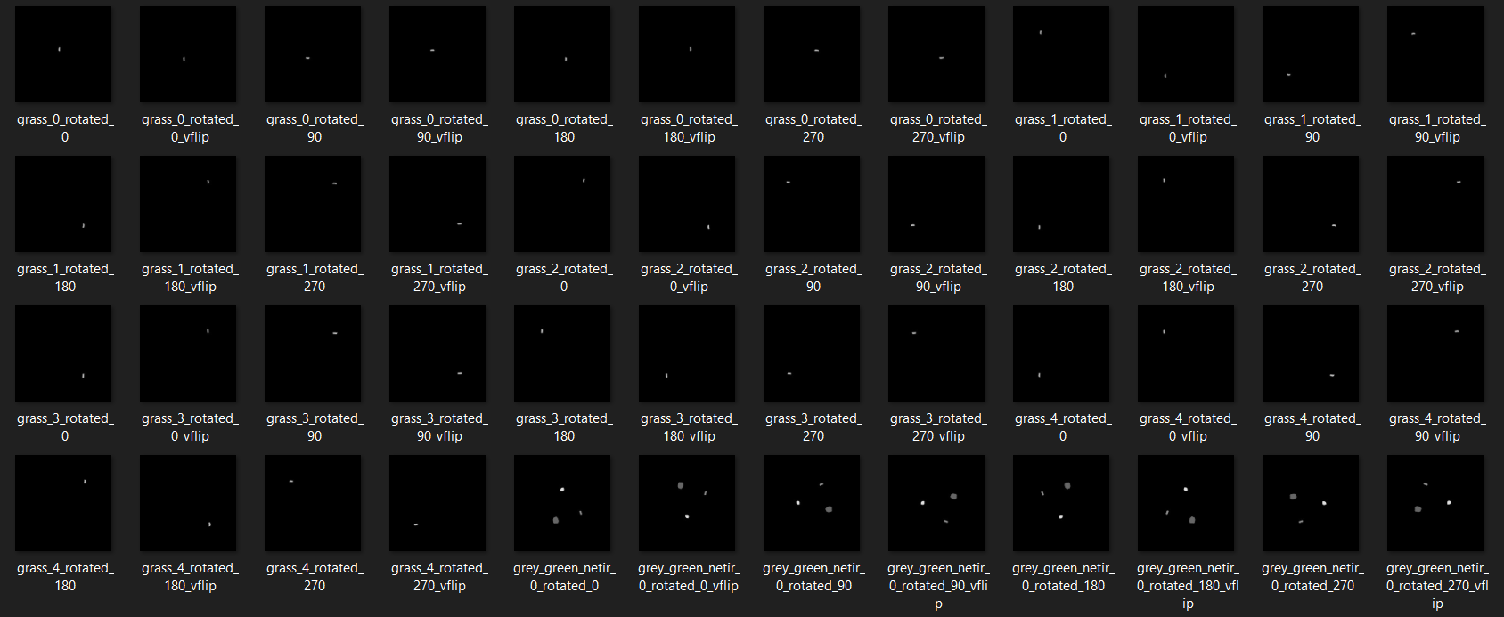
Experimental Setup
Datasets Used
(III) For training model over Multi-spectral Images, we used drone data obtained from GitHub along with its GT.
Multispectral Augmented Dataset (Image + GT)

Slide 19
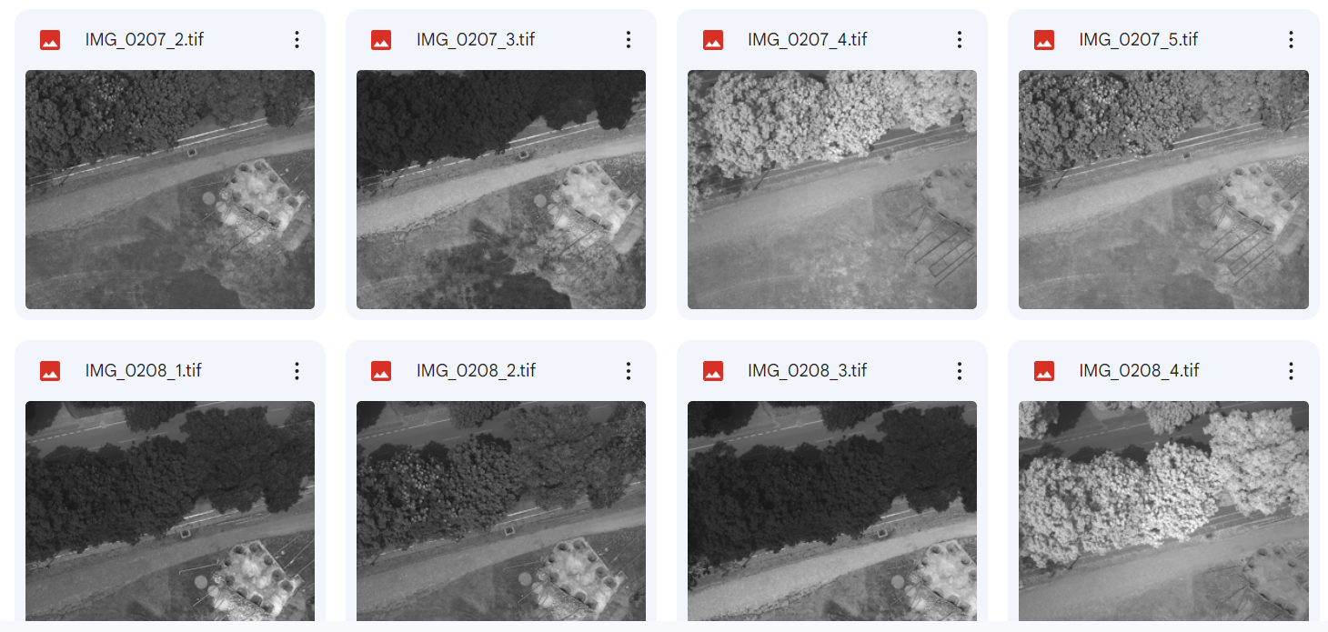
Experimental Setup
Datasets Used
(IV) Drone Data provided in the Lab.

Slide 20
Experimental Setup
How to run the model
Clone our repository from GitHub.
Download the required Python libraries as specified in ‘requirement.txt’ file.
Create folder naming ‘Dataset’ and create sub-folders naming ‘Train’ and ‘Test’ in it.
Create a ‘Model’ folder to store the weights of our model, and a ‘Result’ folder to store the resultant grayscale images obtained.
Then download the datasets from the drive links provided in ‘Dataset.txt’.
To run our model, the device should have CUDA support which is used to make training process faster by using GPUs for general-purpose computing using parallel computing.
CUDA Toolkit can be installed using the Microsoft Installation Docs for it.

Slide 21
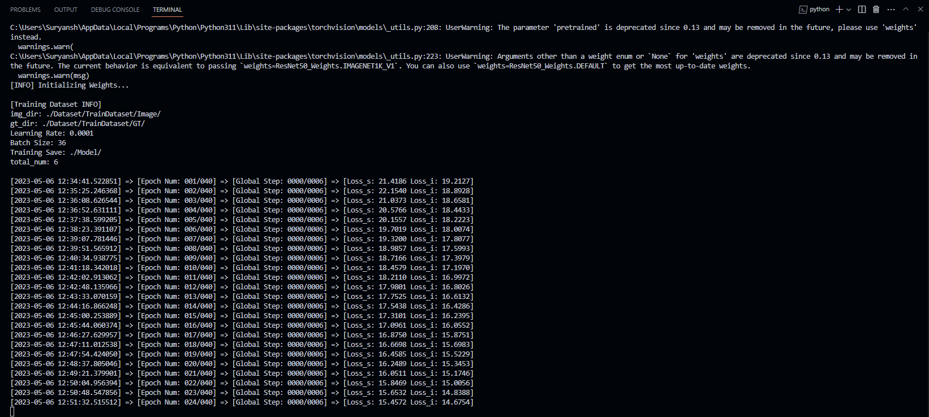
Experimental Setup
How to run the model
Start training by running ‘MyTrain.py’

Slide 22
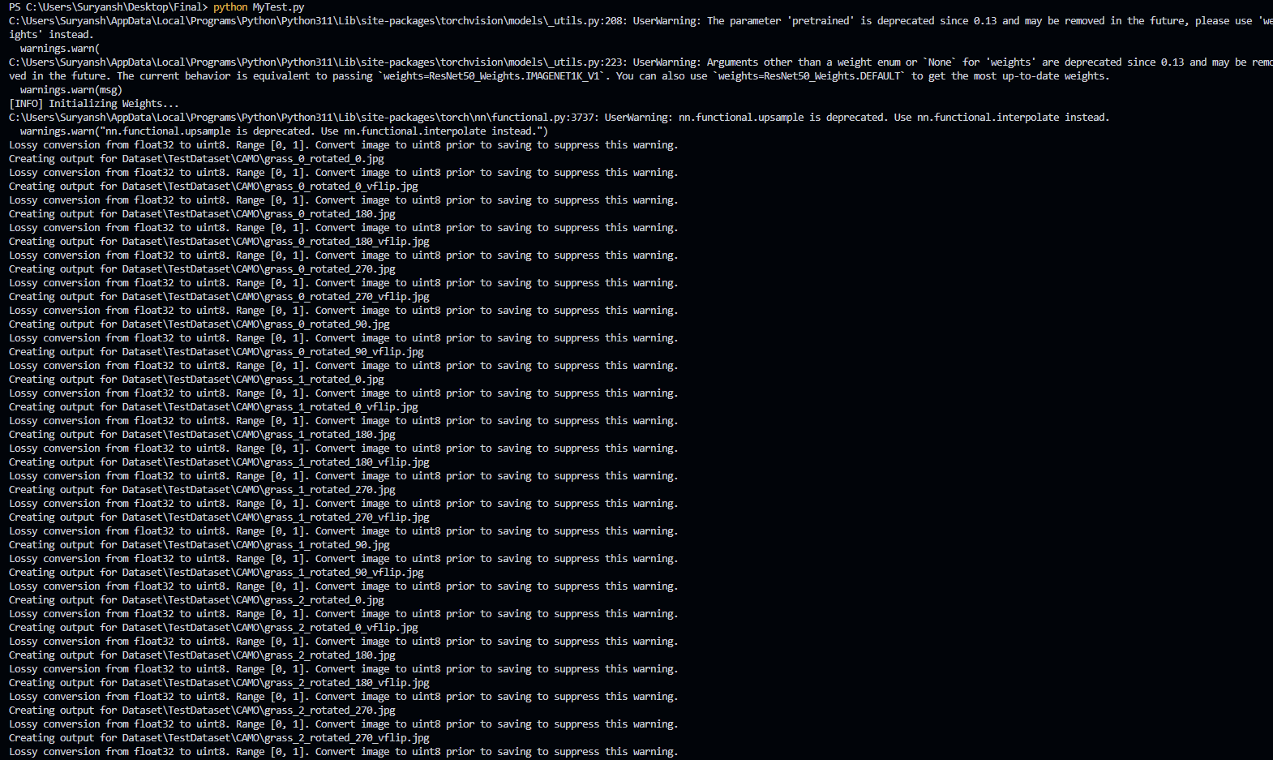
Experimental Setup
How to run the model
Test the model by running ‘MyTest.py’ file.

Slide 23
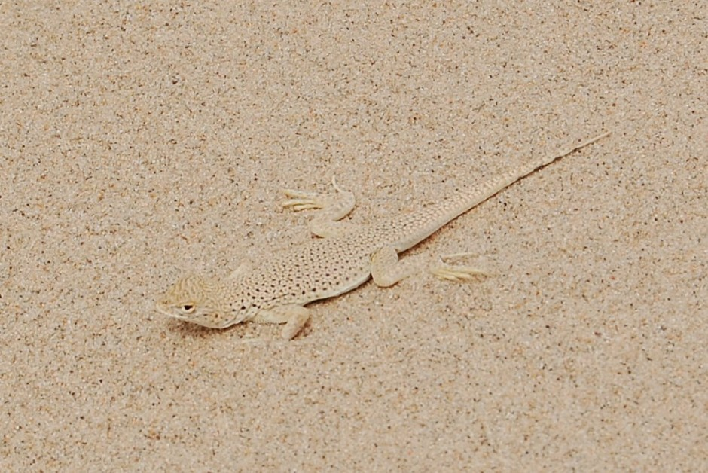
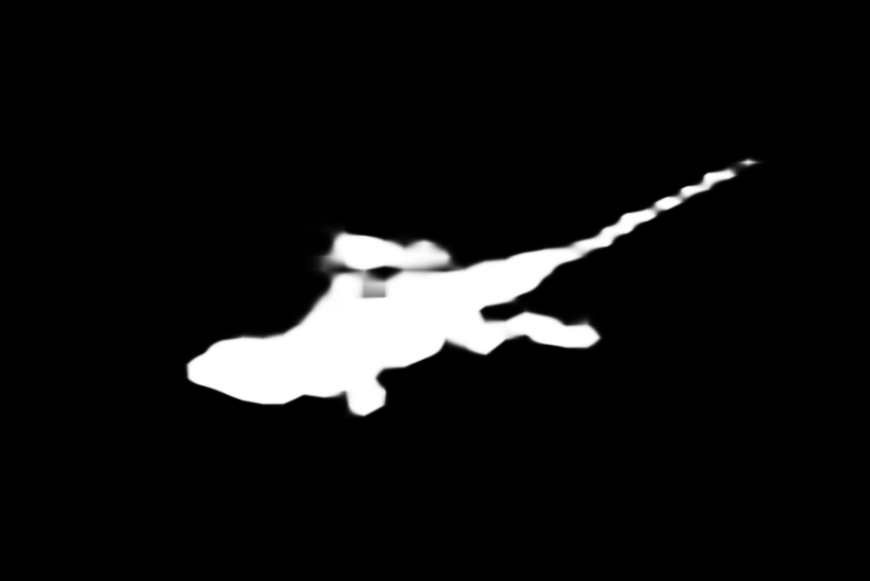
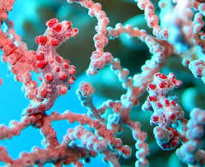
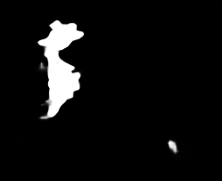
Results and outcomes
Results on RGB Images

Slide 24
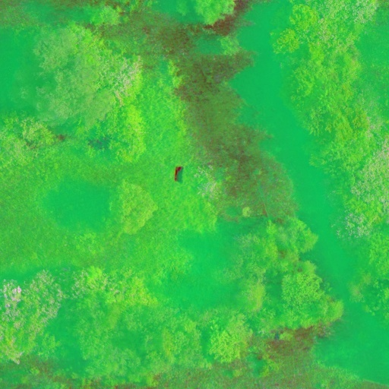
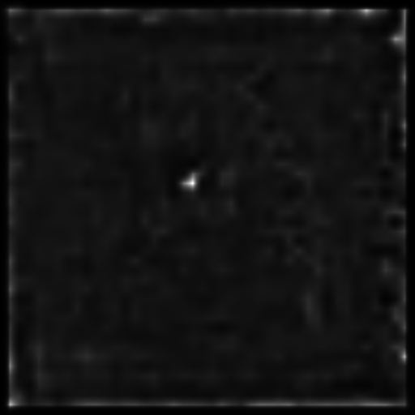
Results and outcomes
Result on Multispectral Image

Slide 25
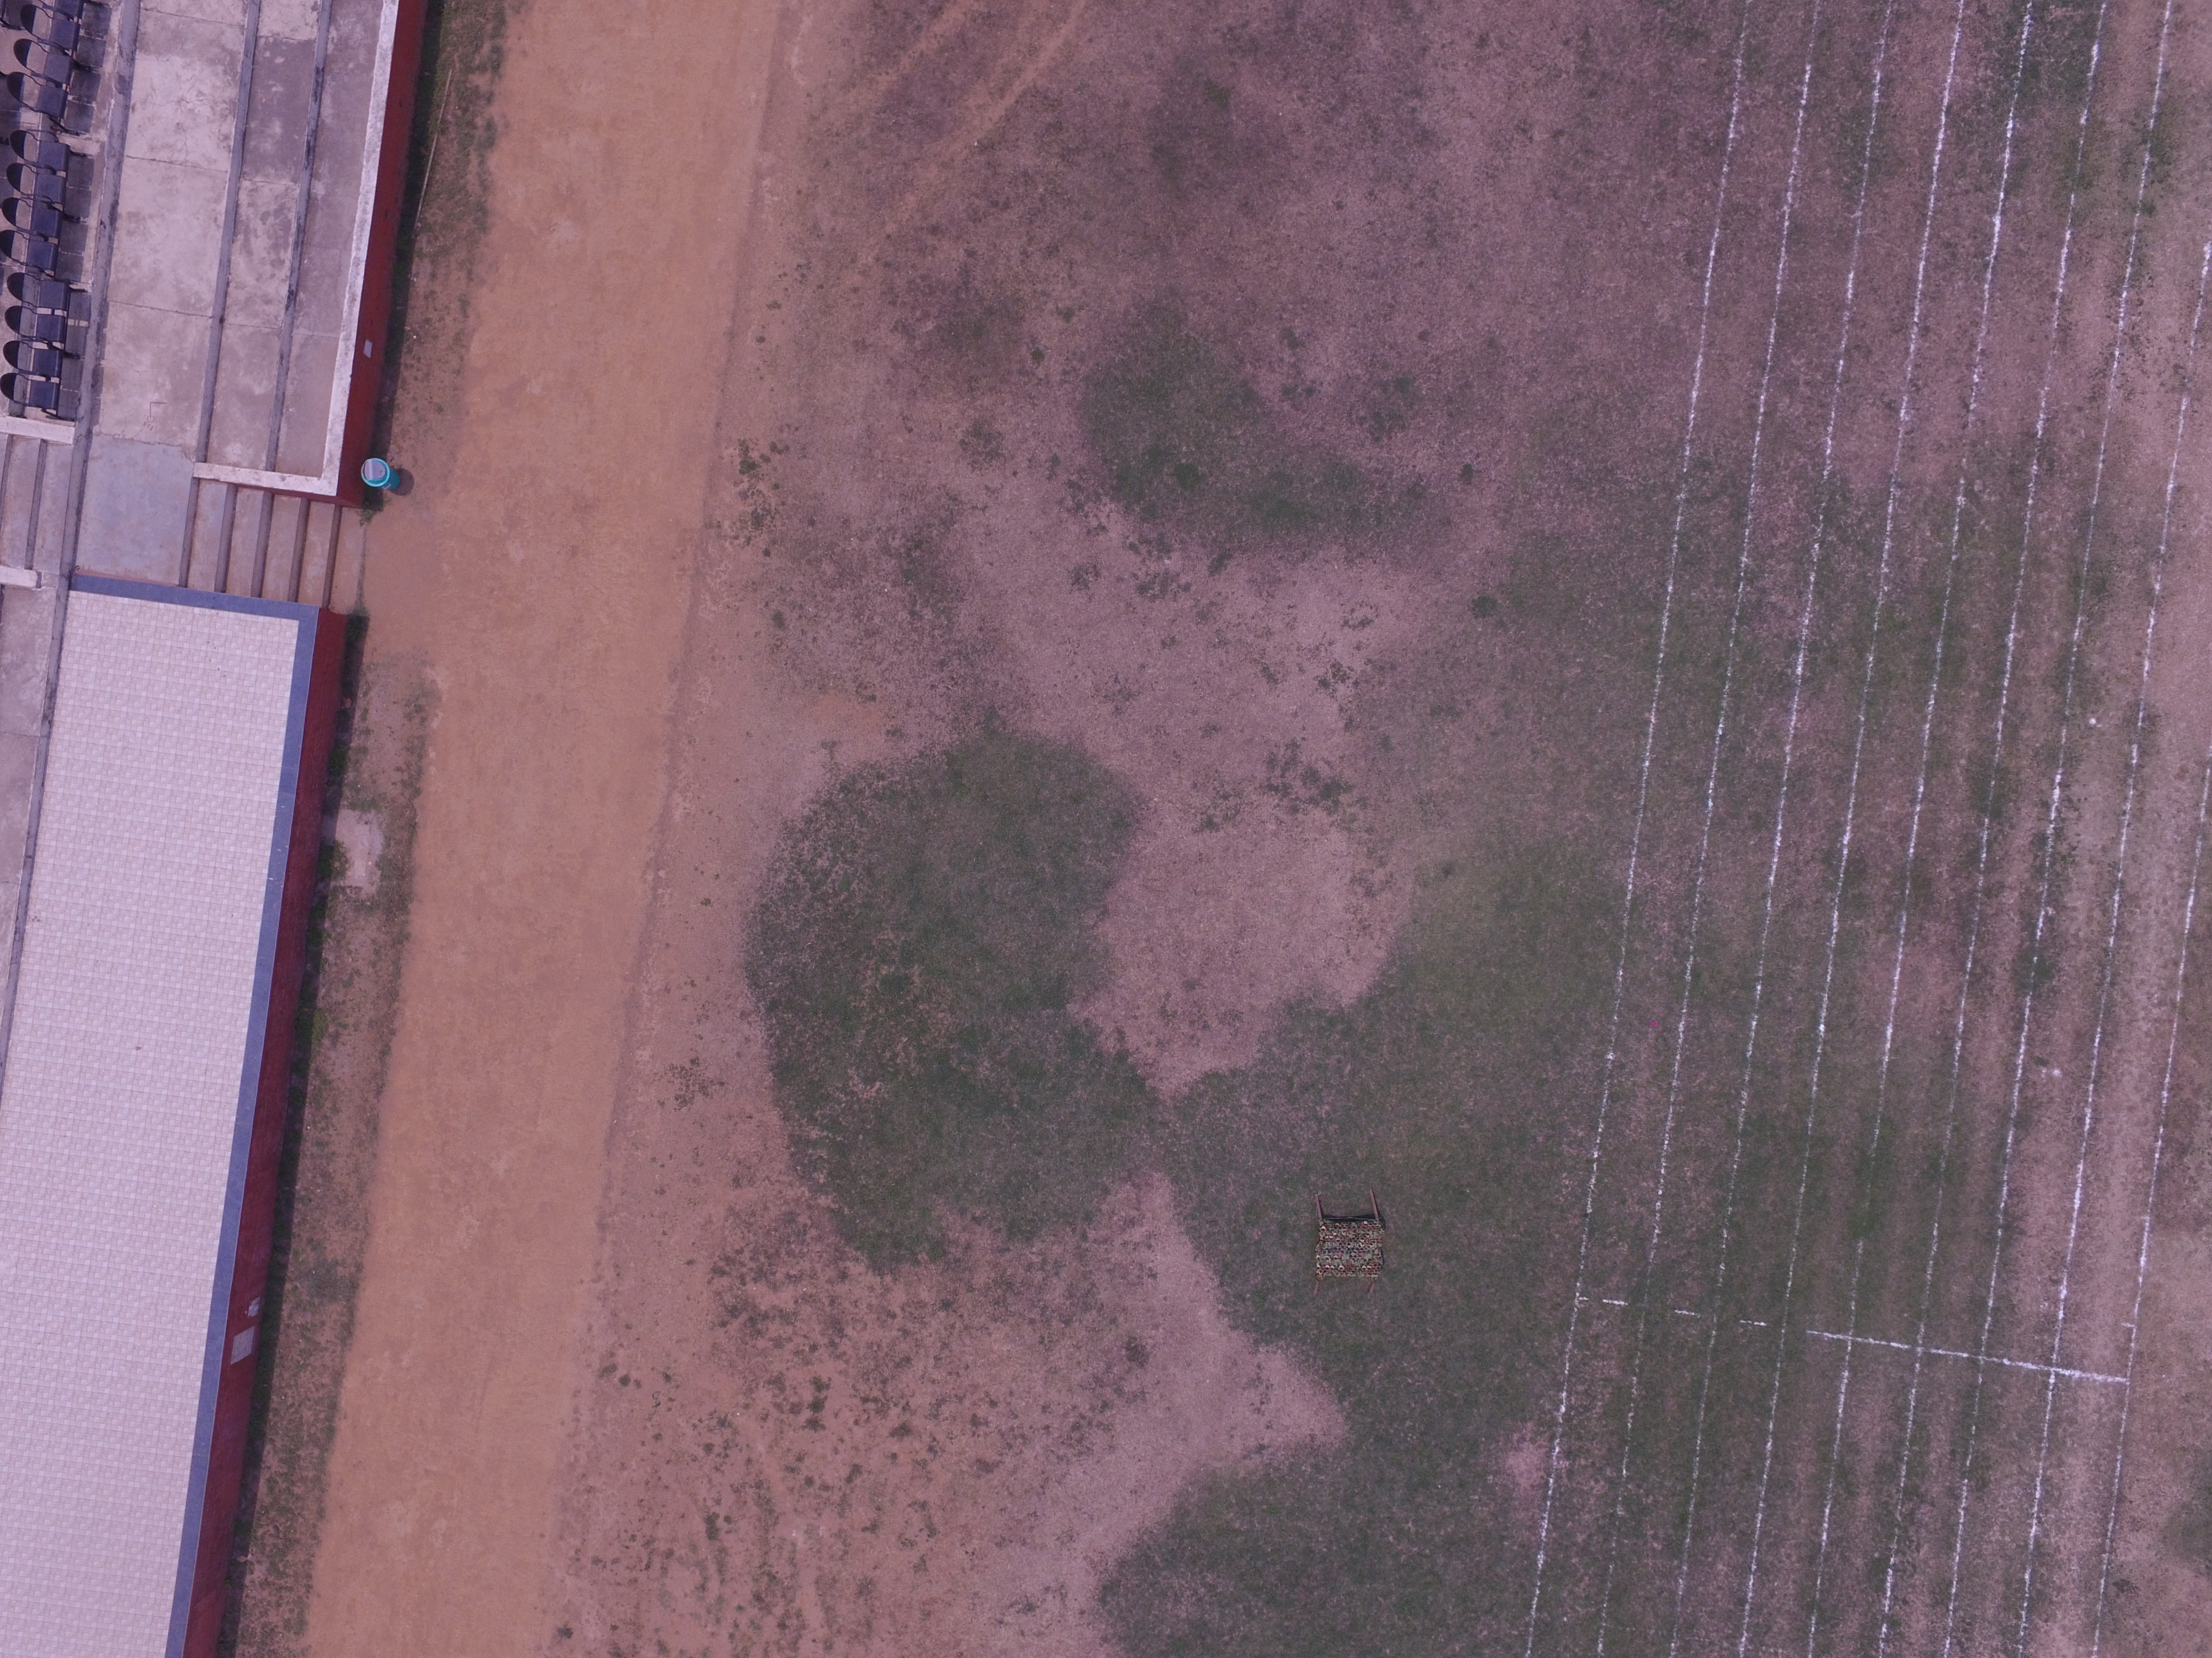
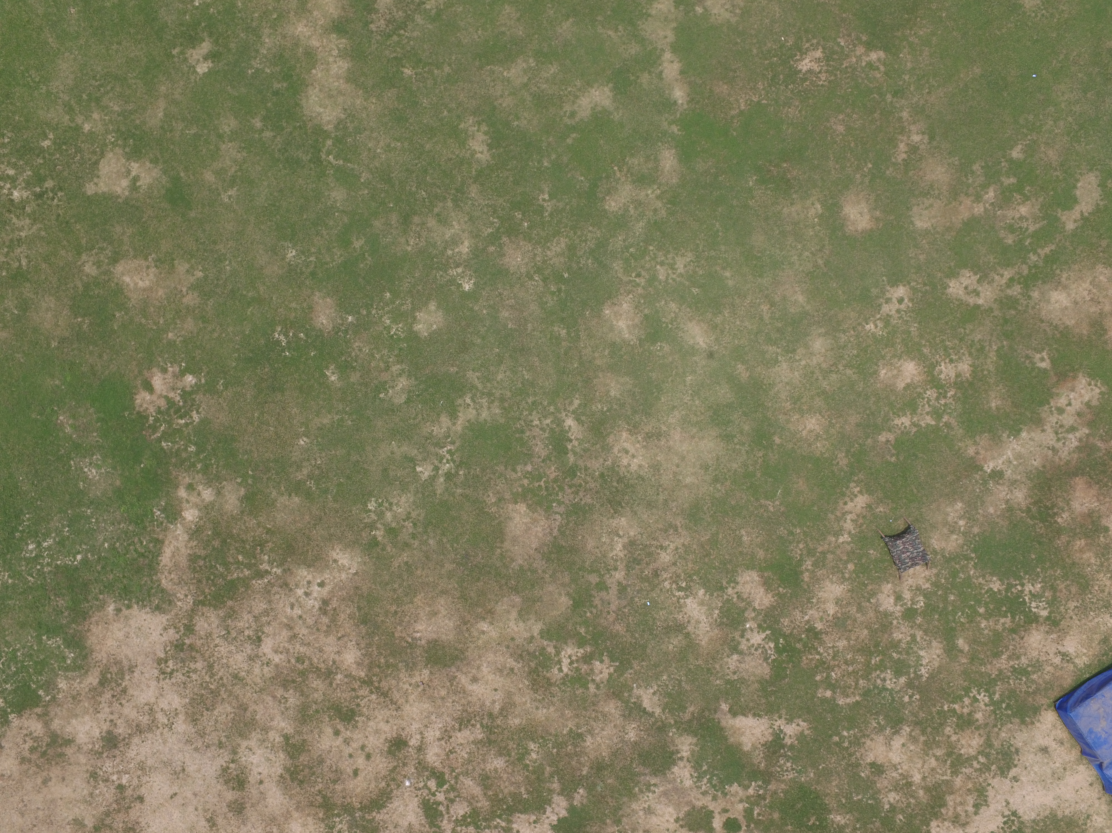
Results and outcomes
RGB Validation Dataset (RGB Drone Images)

Slide 26
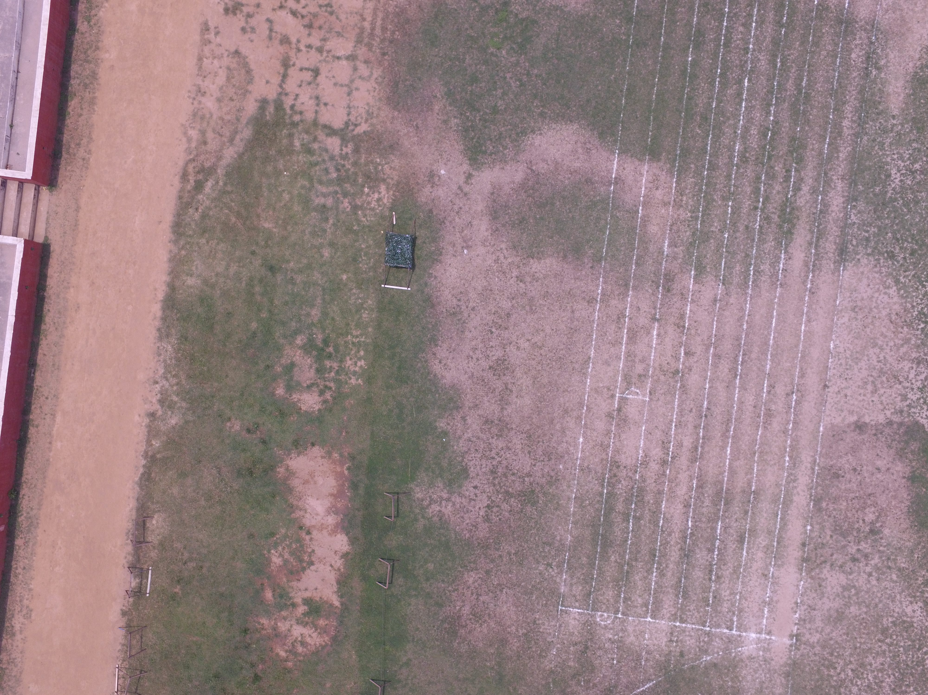
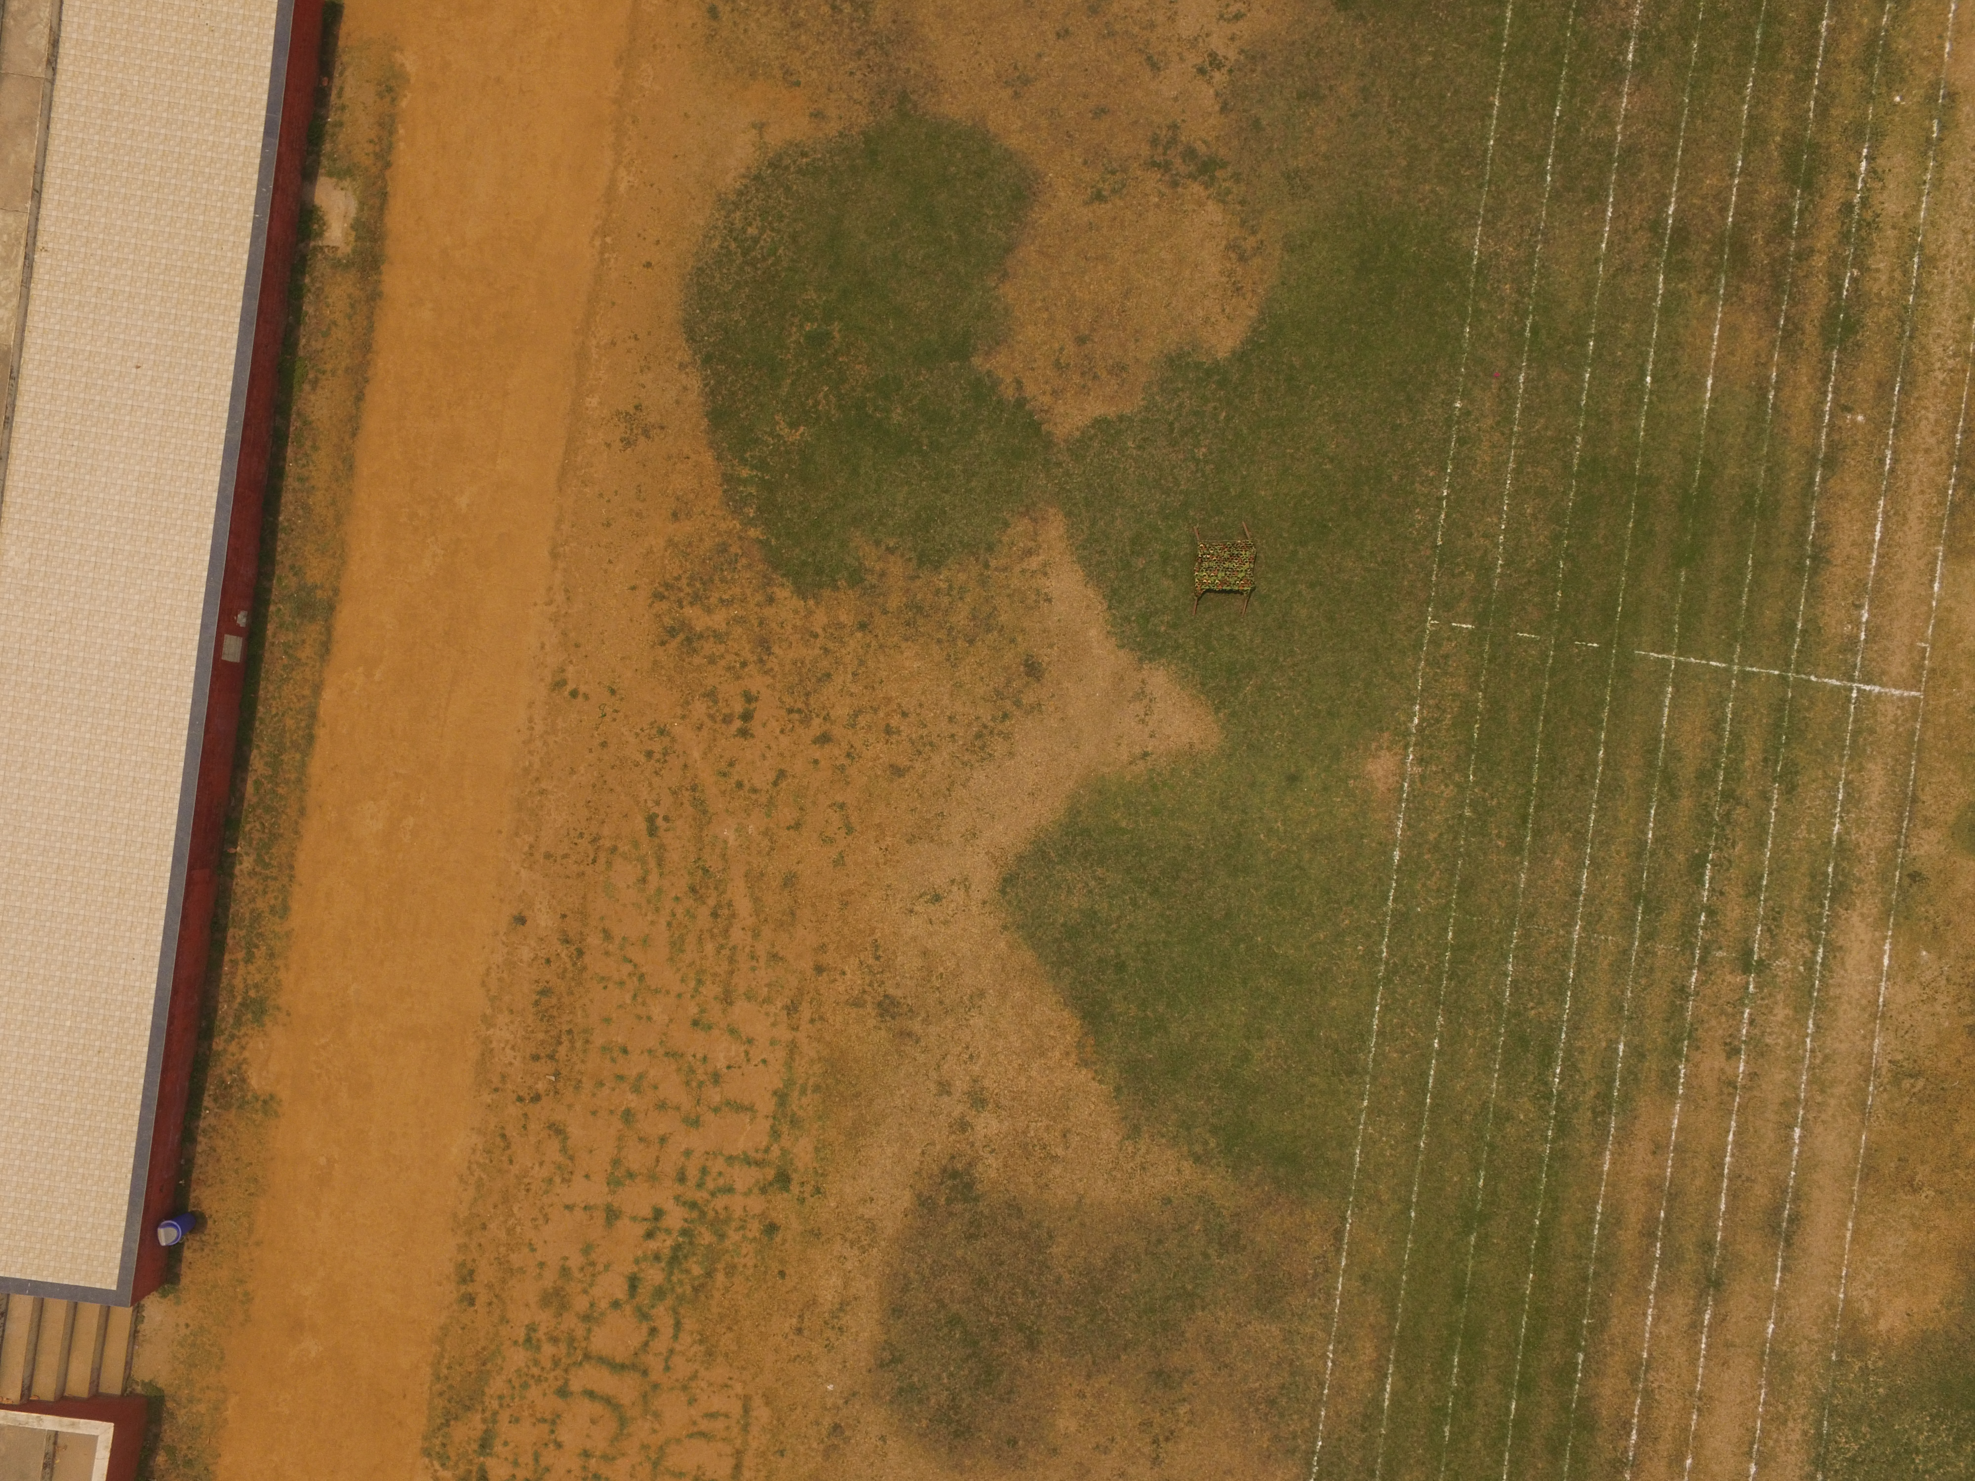
Results and outcomes
RGB Validation Dataset (RGB Drone Images)

Slide 27
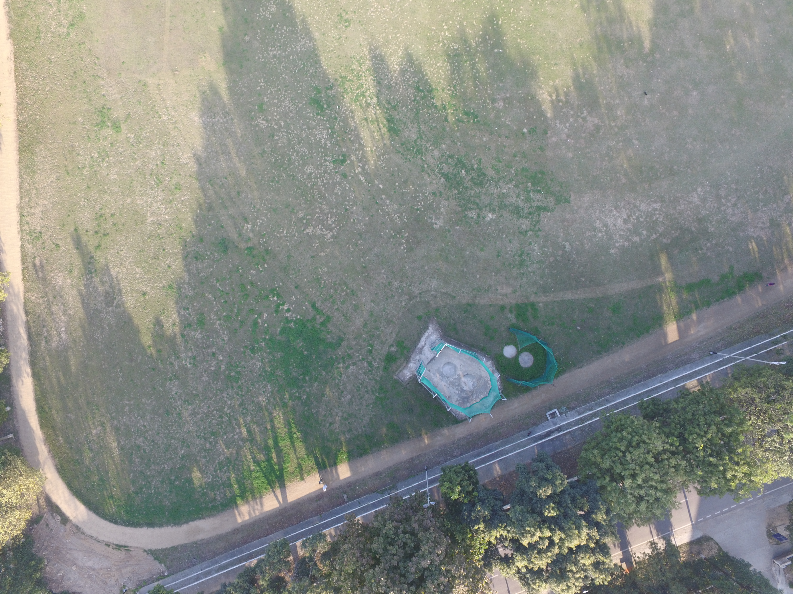

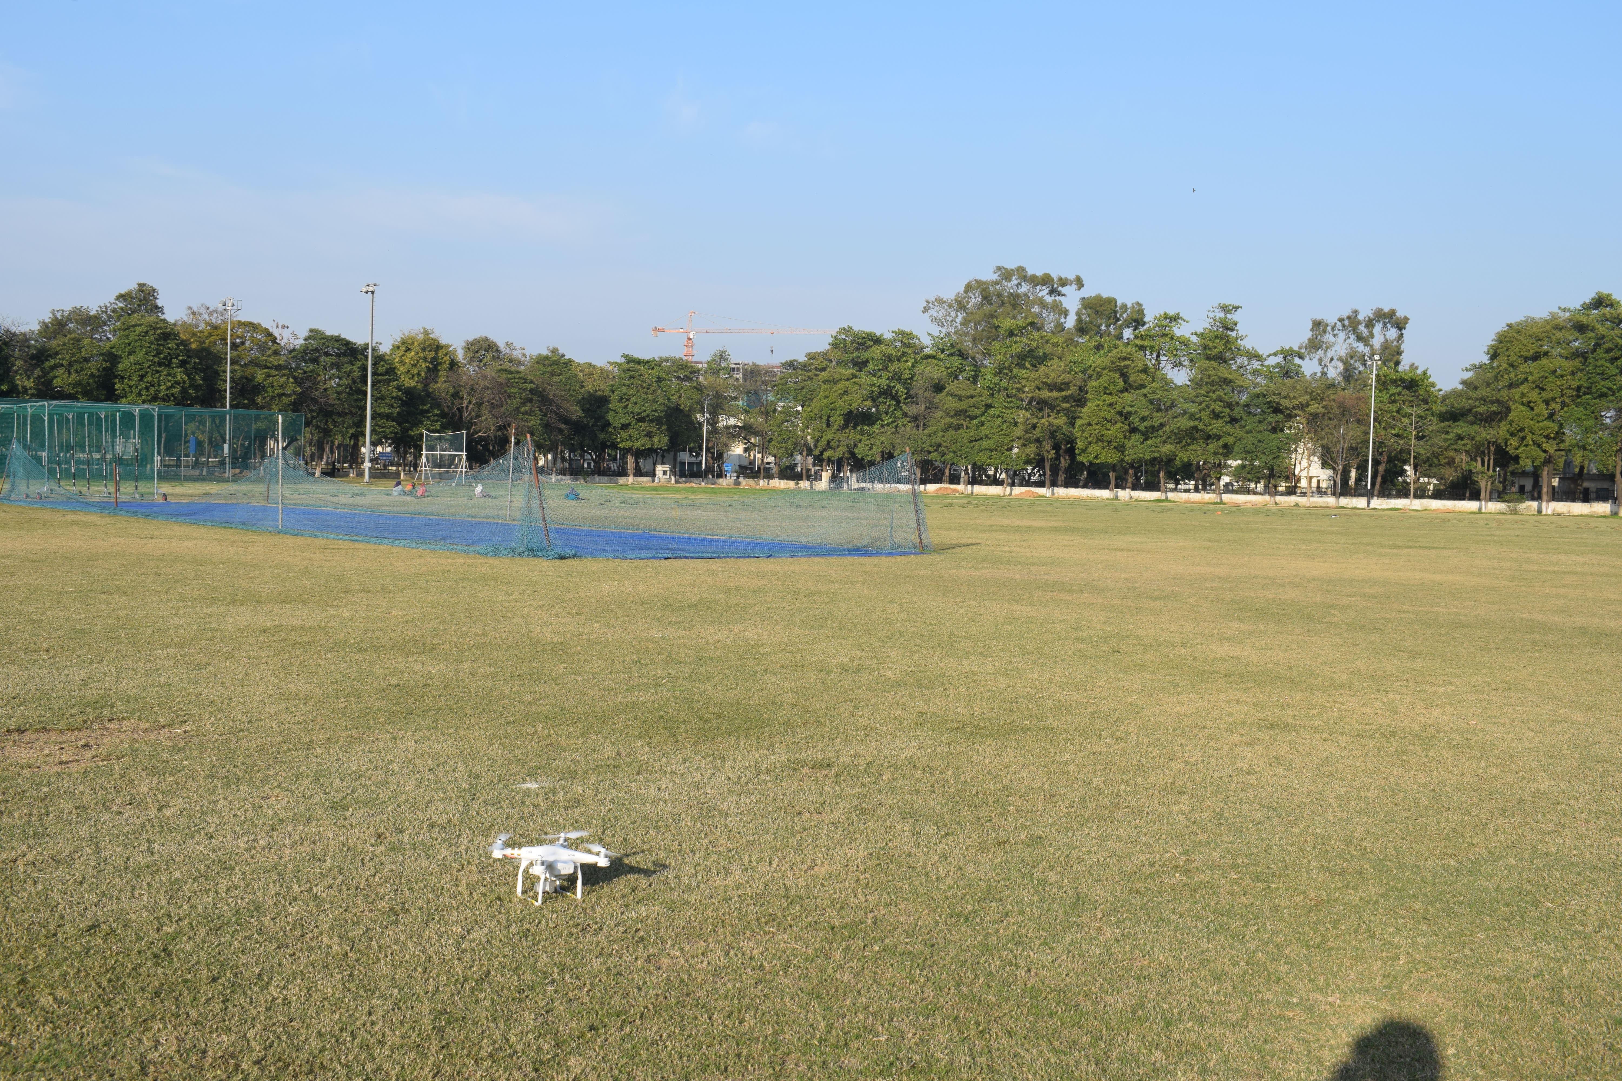
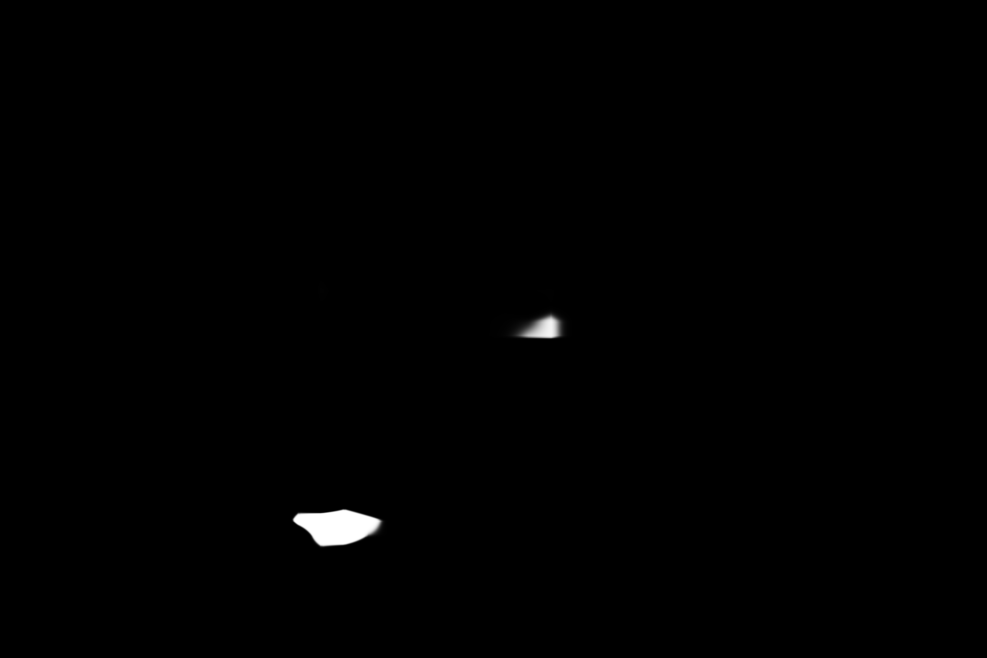
Results and outcomes
RGB Validation Dataset (RGB Drone Images)

Slide 28
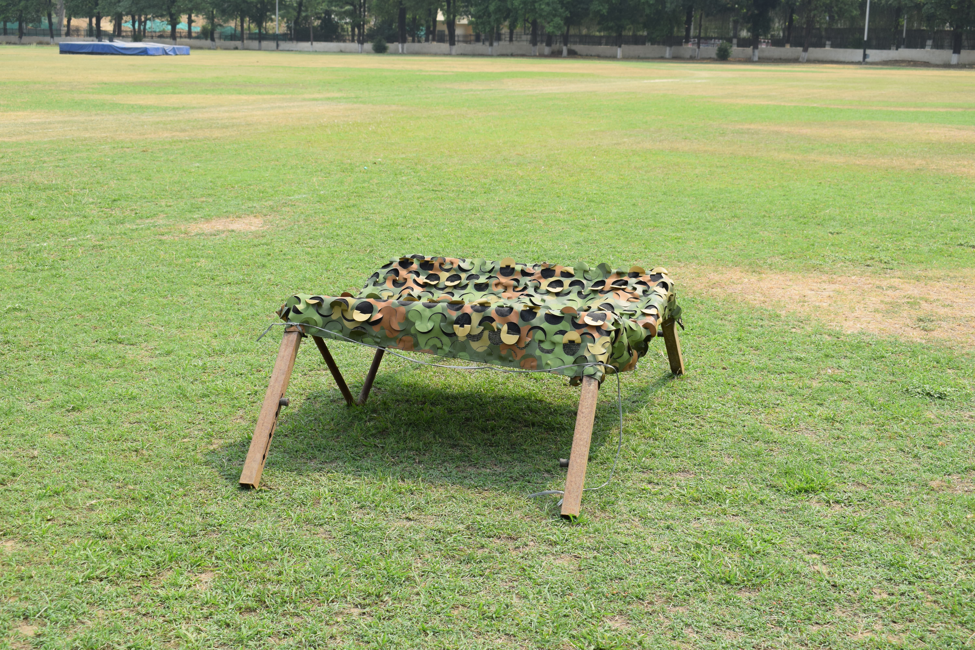
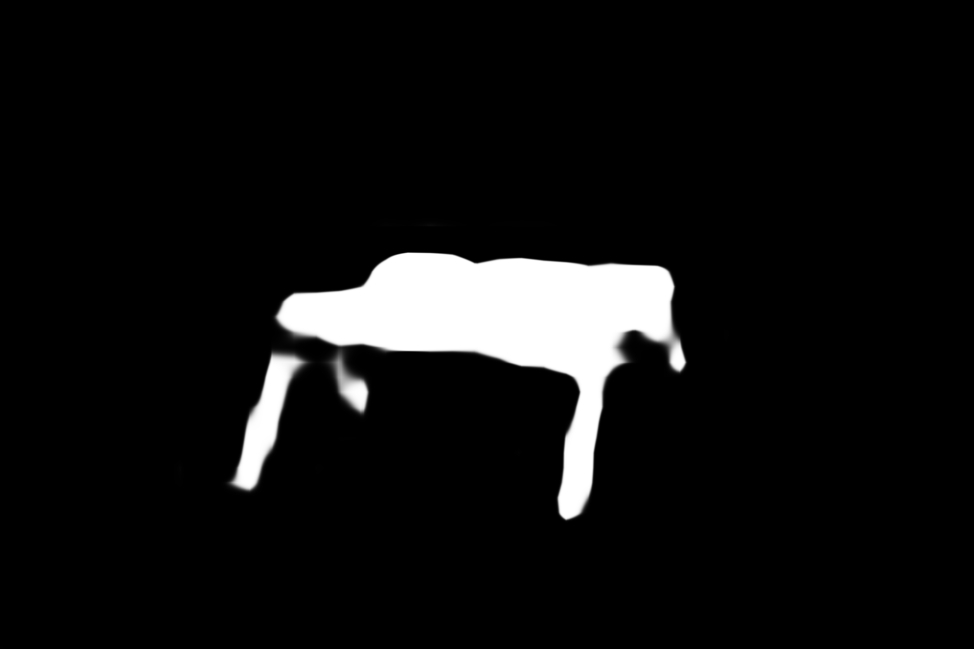
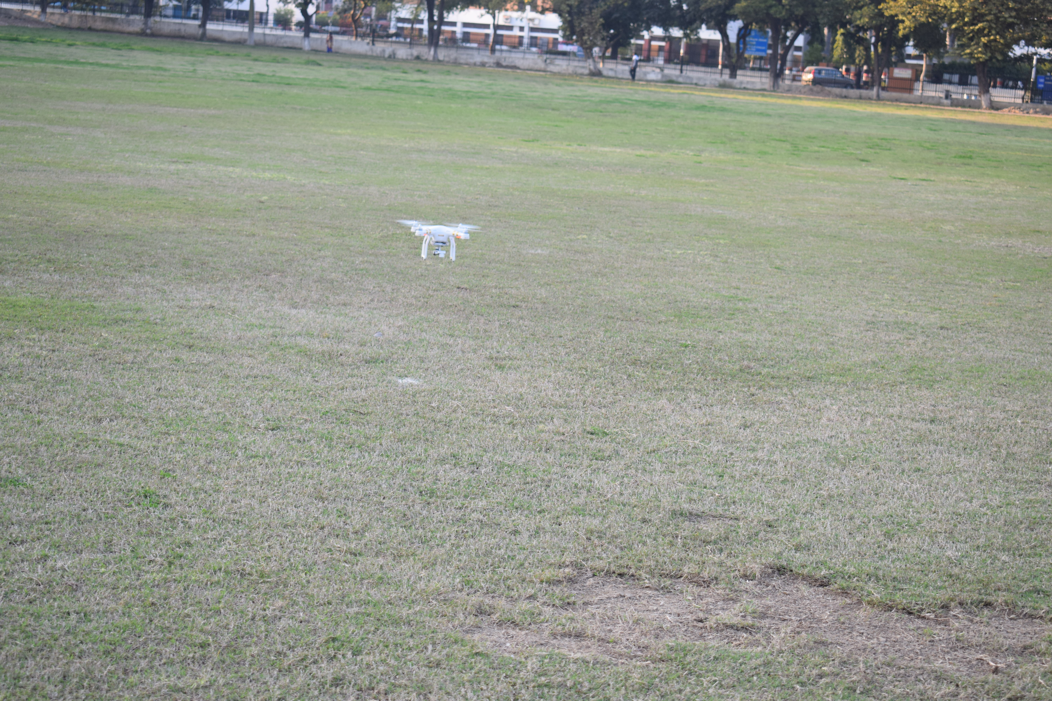

Results and outcomes
RGB Validation Dataset (RGB Drone Images)

Slide 29
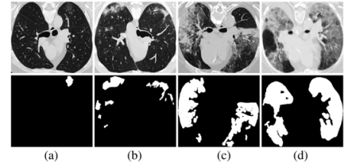
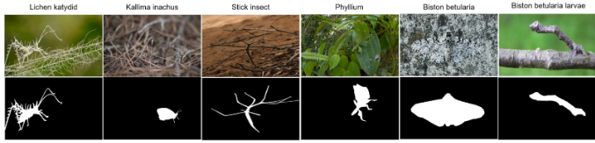
Applications
Medicine
Agriculture
Lung Infection Segmentation
Pest Detection

Slide 30
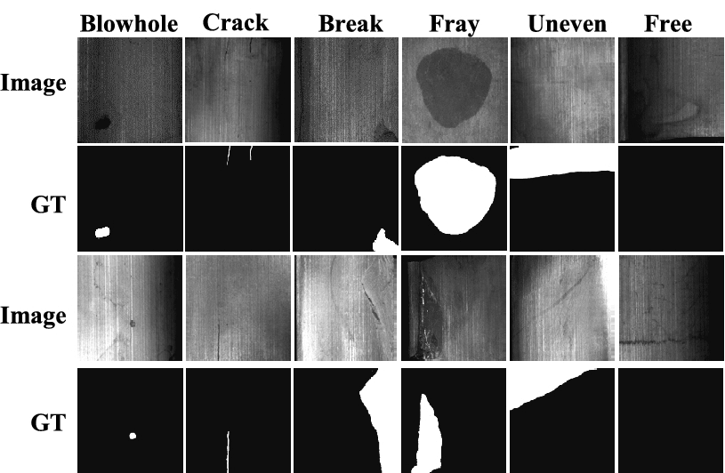
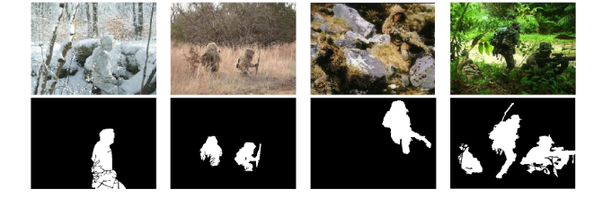
Applications
Manufacturing
Military
Surface Defect Detection
Camouflaged military personnels indifferent environments

Slide 31
Other Fields Explored
Image Classification and Object Detection
YOLO for Image Classification and Object Detection.
We prepared an object detection model using YOLOv3 which was trained on COCO dataset, but it was not able to detect camouflage.
RCNN and Mask-RCNN for image segmentation.

Slide 32
Conclusion
In our study, we conducted an extensive investigation into object detection in camouflaged environments.
We utilized both RGB and multi-spectral datasets to evaluate the effectiveness of different object detection techniques.
In addition, we created our own dataset using drone imagery to simulate real-world scenarios and enhance the accuracy of our findings.
We use PCA for combining multi-spectral images and SINet architecture in our object detection model to obtain the output.
However, despite the impressive results, our model still has certain limitations. This is because the field of object detection in camouflaged environments is still relatively new in the deep learning domain. As such, there is still much room for improvement, and we believe that future research and advancements will continue to enhance the effectiveness of object detection in camouflaged environments.

Slide 33
Future Scope
The field of camouflaged object detection has great potential for future advancements, and there are several areas that could be explored to improve the effectiveness of detection models. Few of them are listed below:
Concealed object detection under limited conditions.
Camouflaged Object Detection combined with other modalities like audio, video, text, etc.
Existing concealed data is only based on static images or dynamic videos. However, concealed object detection in other modalities can be closely related in domains such as pest monitoring in the dark night, robotics, and artist design.

Slide 34
Contribution of Group Members
Suryansh Singh
Simulation modelling/algorithm
Flowchart/system design
Experimental setup
Results/outcomes findings and validation
Documentation
Object Detection Model
Report preparation
Pranay Parashar
Dataset Preparation
Simulation design
Specifications analysis

Slide 35
Contribution of Group Members
Simulation modelling/algorithm
Experimental setup
Results/outcomes findings and validation
Shrayash Prasad
Simulation modelling/algorithm
Flowchart/system design
Experimental setup
Results/outcomes findings and validation
Documentation and Final Presentation
Report preparation

Slide 36
References
H. Park, L. Sjosund, Y. Yoo, N. Monet, J. Bang, and N. Kwak, "SINet: Extreme Lightweight Portrait Segmentation Networks with Spatial Squeeze Modules and Information Blocking Decoder," in Proceedings of the IEEE/CVF Winter Conference on Applications of Computer Vision (WACV), Colorado, USA, Mar. 2020, pp. 2055-2063, doi:10.1109/WACV45572.2020.9093588.
M. Gagolewski, "Data Fusion: Theory, Methods, and Applications," Warsaw, Poland: Wydawnictwo Naukowe PWN, Dec. 2015, ISBN: 978-83-63159-20-7, doi: 10.5281/zenodo.6960327.
J. Bleiholder and F. Naumann, "Data Fusion," ACM Comput. Surv., vol. 41, no. 1, Dec. 2008, doi: 10.1145/1456650.1456651.
Z. Wang, J. Chen, C. Li, X. Liu, C. Li, H. Li, Z. Li, J. Li, and T. Li, "Deep Reinforcement Learning for Autonomous Driving: A Survey," arXiv preprint arXiv:2010.06791, 2020.
Y. Jin, Y. Hu, Z. Jiang, and Q. Zheng, "Polyp segmentation with convolutional MLP," The Visual Computer, Aug. 2022, doi: 10.1007/s00371-022-02630-y.
L. Zhao, M. Zhang, H. Ding, and X. Cui, "MFF-Net: Deepfake Detection Network Based on Multi-Feature Fusion," Entropy, vol. 23, no. 12, Dec. 2021, p. 1692, doi: 10.3390/e23121692.
S. S. Heera, "Understanding Binary Cross-Entropy / Log Loss: A Visual Explanation," Towards Data Science, 2019. [Online]. Available: https://towardsdatascience.com/understanding-binary-cross-entropy-log-loss-a-visual-explanation-a3ac6025181a. [Accessed: May. 07, 2023].
S. Malek, M. Mosleh, S. K. Dhillon, and P. Milow, "Bioimage Informatics," in Encyclopedia of Bioinformatics and Computational Biology, S. Ranganathan, M. Gribskov, K. Nakai, and C. Schönbach, Eds. Oxford: Academic Press, 2019, pp. 993-1010. doi: 10.1016/B978-0-12-809633-8.20308-7.
MyGreatLearning, "Feature Extraction in Image Processing," [Online]. Available: https://www.mygreatlearning.com/blog/feature-extraction-in-image-processing/. [Accessed: May 5, 2023].
R. Calvini, A. Ulrici, and J. M. Amigo, "Growing applications of hyperspectral and multispectral imaging," in Hyperspectral Imaging, J. M. Amigo, Ed. Elsevier, vol. 32, 2019, pp. 605-629. doi: 10.1016/B978-0-444-63977-6.00024-9.

Slide 37
References
Edmund Optics, "Hyperspectral and Multispectral Imaging," [Online]. Available: https://www.edmundoptics.eu/knowledge-center/application-notes/imaging/hyperspectral-and-multispectral-imaging/. [Accessed: May 5, 2023].
J. Howard and S. Ruder, "Universal Language Model Fine-tuning for Text Classification," arXiv preprint arXiv:1807.09940, 2018.
Papers with Code, "Camo: A Multi-View Dataset for Vehicle Re-Identification," [Online]. Available: https://paperswithcode.com/dataset/camo. [Accessed: May 5, 2023].

